Slide 1

BE 21 SKILLED TEACHER EMPOWERMENT PROGRAM
MODULE 5
21CS INTEGRATION
www.be21skilled.eu
INTO CURRICULUM

Slide 2

TABLES OF CONTENTS
Module 5 Introduction
01
Curriculum Design for 21CS
02
Mapping 21CS to STEM Subjects
03
Interdisciplinary Approaches
04
Leveraging Technology for Curriculum Integration
05
Professional Development and Continuous Learning
This work is licensed under a Creative Commons Attribution-Non-Commercial-No Derivatives 4.0 International License (CC BY-NC-4.0) International License.
Project number: 2021-1-LV01-KA220-HED-000027581

Slide 3

MODULE 5 INTRODUCTION
Module 5 is designed to equip educators with the inspiration and knowledge of approaches, strategies and tools to bring 21CS into and across their STEM curricula.
It introduces a blend of pedagogical frameworks, practical strategies, and real-world case studies, to help educators learn how to redesign or reframe their curricula to not only convey disciplinary knowledge but also foster the broad range of skills students need to thrive in an increasingly complex and technology-driven world.
3

Slide 4

INTRODUCTION By completing Module 5, our educators will acquire learning in 4 key competencies :
Curriculum Integration Skills: Educators will develop the ability to integrate 21st-century skills (21CS) into STEM curricula and create engaging learning environments and experiences that fosters interdisciplinary knowledge and practical application of these essential skills.
Proficiency in Mapping 21CS to STEM Subjects: Educators will gain an understanding of how to effectively align the fundamental elements of 21CS with the learning objectives and content of STEM.
Instructional Design for 21CS: Educators will gain insights on the application of pedagogical approaches such as project-based learning, inquiry-based learning, and problem-based learning, for engaging students in active learning and real-world problem-solving.
Enhanced CDP: The module will enhance educators' capabilities in pursuing continuous professional development focused on 21CS education. Participants will engage in a reflective/foresight exercise to consider strategies for building and participating in communities of practice and promoting a culture of continuous improvement and innovation in STEM education.
4

Slide 5


Curriculum Design for 21CS
01
5

Slide 6
Foundations of Curriculum Design for 21CS Integration
Curriculum design in the context of higher education increasingly demands the integration of 21st-century skills (21CS) to address the gap between traditional academic objectives and the competencies required in modern and future workplaces. In many cases, this necessitates a strategic overhaul of curriculum frameworks to embed critical thinking, problem-solving, collaboration, and digital literacy as core components.
The type of curriculum we are suggesting transcends disciplinary boundaries, fostering a learning environment that is not only interdisciplinary but also deeply connected to real-world contexts and challenges.

Slide 7

3 Principles for Integrating 21CS into Curriculum
First, the curriculum must be learner-centered, focusing on developing students' abilities to navigate complex problems and work collaboratively in diverse teams. Second, it should promote active learning through engagement with real-world challenges that require creative solutions. Finally, the design process must be iterative, allowing for continuous refinement and adaptation based on feedback and changing educational or industry standards.

Slide 8
Aligning Learning Outcomes with 21CS Competencies
A critical step in curriculum development for 21CS integration is the alignment of learning outcomes with specific 21CS competencies.
This involves a detailed mapping process where traditional academic goals are paired with the skills and abilities that students need to succeed in a complex, globalised society as reflected in 21CS competencies. See Section 2 for more details.
Such alignment ensures that each course component—from lectures and seminars to projects and assessments—contributes to the holistic development of students, equipping them with a balanced mix of knowledge, skills, and attitudes.

Slide 9

Operationalising 21CS in Curriculum Design
Operationalising 21CS within the curriculum requires a clear strategy for embedding these competencies into both the content and delivery of education.
This involves identifying opportunities for skill development across all disciplines and integrating pedagogical approaches that support active learning, such as project-based learning, flipped classrooms, and collaborative assignments. It also necessitates the use of assessment methods that can accurately measure the development of 21CS, providing meaningful feedback to students on their progress and areas for improvement. (see Module 4).

Slide 10

Mapping 21CS to STEM Subjects
02
10

Slide 11

Mapping 21CS to STEM Subjects
Mapping 21st-century skills (21CS) to specific STEM curricula is a critical process for educators aiming to prepare students for the complexities of modern and future workplaces.
In the slides which follow, we provide some inspiration on how key 21CS can be integrated into various STEM fields.

Slide 12
Case Based Guide to Mapping 21CS in STEM Subjects
Background:
At a prominent university's engineering department, faculty members noticed a gap between the technical skills taught in their courses and the competencies graduates needed in the workforce, particularly in terms of problem-solving, teamwork, and digital literacy. To address this, the department embarked on a curriculum mapping process aimed at integrating 21st Century Skills (21CS) into their existing programmes.
The Challenge:
The primary challenge was ensuring that the integration of 21CS did not dilute the technical rigour of the engineering curriculum but instead complemented and enhanced it. Educators needed to identify where in the curriculum these skills could naturally align with technical content to foster a holistic educational experience.

Slide 13
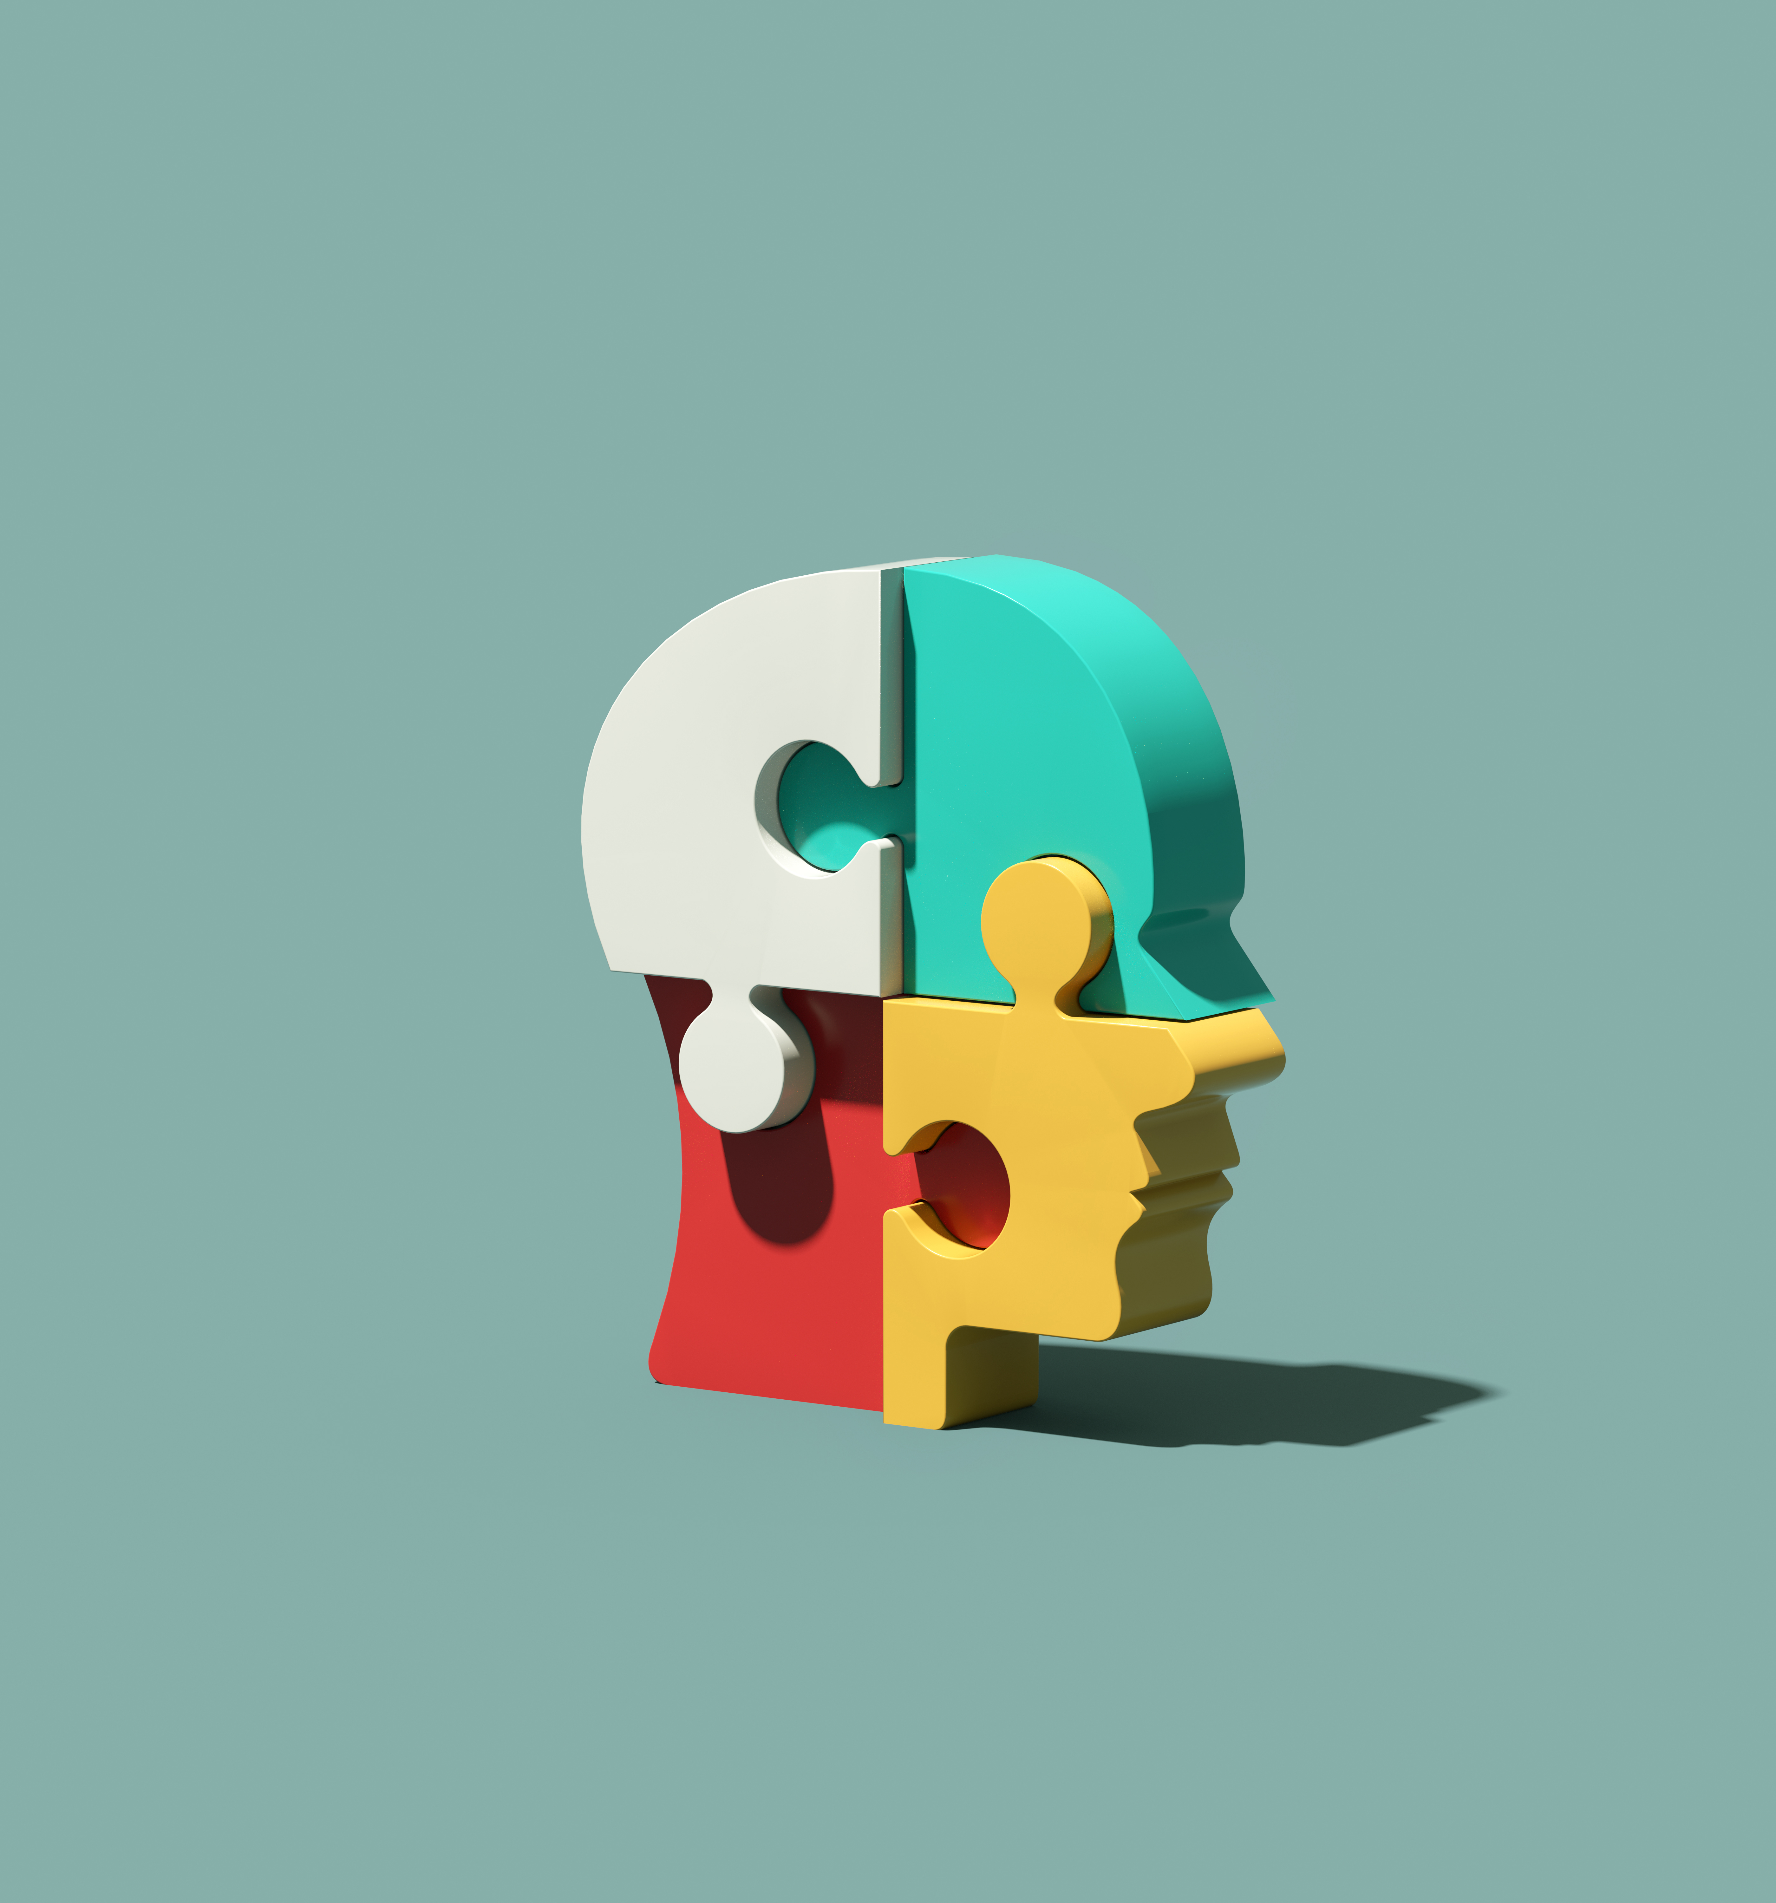
Case Based Guide to 21CS to STEM Subjects
The Mapping Process:
Identification of 21CS Competencies: The team started by defining the specific 21CS critical to engineering careers using the Be 21 Skilled Toolkit which categorises 21CS into 7 key areas (download from https://be21skilled.eu/ )
01: Self-Management, Purposefulness, Perseverance
Relevance to Engineering: Engineering projects often span long periods and involve complex, sometimes frustrating, phases of development, testing, and implementation. The ability to manage one’s time, stay focused on objectives despite setbacks, and persist through challenges is critical for success.

Slide 14

Case Based Guide to 21CS to STEM Subjects
02: Critical Thinking, Problem-Solving, Systems Thinking
Relevance to Engineering: Engineering is fundamentally about solving problems—designing solutions that meet specific needs or address particular challenges. Critical thinking allows engineers to evaluate alternatives and make decisions based on evidence and logic. Systems thinking enables them to see the bigger picture, understanding how different parts of a system interact and affect each other.
03: Communication, Collaboration, Teamwork
Relevance to Engineering: Effective communication and teamwork are vital in engineering, where projects often require multidisciplinary collaboration. Engineers must articulate ideas clearly and work well with others, including those from different backgrounds and with different perspectives.

Slide 15

04: Adaptability, Resilience, and Stress Resistance Relevance to Engineering: The field of engineering is constantly evolving with technological advances and shifting societal needs. Engineers must adapt to new tools, processes, and regulations. Resilience and stress resistance are crucial for navigating tight deadlines and high-stakes projects.
05: Creativity, Curiosity, Open Mindset, Spotting Opportunities Relevance to Engineering: Creativity and curiosity drive innovation in engineering. An open mindset allows engineers to explore unconventional solutions and spot opportunities for improvement or innovation within existing systems.

Slide 16

06: Wellbeing, Positive Attitude, Mindfulness Relevance to Engineering: The demanding nature of engineering work can impact personal wellbeing. A positive attitude and mindfulness can enhance mental health, improve focus, and foster a supportive work environment.
07: Emotional Intelligence and Empathy Relevance to Engineering: Emotional intelligence and empathy are key for working effectively with diverse teams, understanding user needs, and leading projects with compassion and understanding. They enhance the capacity to respond to feedback, navigate interpersonal challenges, and ensure that engineering solutions are human-centered.

Slide 17
Case Based Guide to 21CS to STEM Subjects
The Mapping Process:
2. Curriculum Review: Faculty members conducted a thorough review of the existing curriculum to identify courses and modules where 21CS were already being addressed and where there were gaps.
3. Gap Analysis: The team performed a gap analysis, comparing the current state of the curriculum against industry needs and the identified 21CS competencies. The one key 21CS skill that was not taught formally was Communications. In engineering , the ability to convey complex technical information clearly and persuasively to a variety of audiences, including technical and non-technical stakeholders encompasses written, oral, and visual communication skills. Engineers must be able to explain their ideas, designs, and solutions to others, including clients, project managers, and the public. Effective communication ensures that ideas are understood, projects are implemented correctly, and innovations are successfully adopted.

Slide 18
Case Based Guide to 21CS to STEM Subjects
The Mapping Process:
4. Integration Strategy Development: For each gap identified, the team developed strategies for integration. This included revising learning outcomes, developing new projects and assignments, and incorporating new teaching technologies.
Implementation:
Project-Based Learning (PBL): The department introduced PBL in several core courses, where students worked in teams to solve real-world engineering problems, fostering collaboration, problem-solving, and technical skills. | Communication Skills: Courses were introduced that focused on technical writing and presentation skills, requiring students to present their projects to an audience of peers and faculty.

Slide 19
Other Implementation Approaches
Science:
Inquiry-Based Learning and Collaboration
Inquiry-Based Learning: Science education benefits greatly from inquiry-based approaches, where students are encouraged to ask questions, conduct experiments, and derive conclusions based on evidence. This method fosters a deep understanding of scientific concepts and the scientific method itself.
Collaboration: Group projects and laboratory work in science classes provide ample opportunities for students to work together, share findings, and debate conclusions, mirroring the collaborative nature of real scientific research.

Slide 20
Other Implementation Approaches
Technology and Computer Science: Digital Literacy and Computational Thinking
Digital Literacy: Given the rapid evolution of technology, fostering digital literacy is crucial for Technology students. Digital Literacy is achieved by integrating coding exercises, software development projects, and the use of various digital tools and platforms into the curriculum.
Computational Thinking: Teaching students to approach problems in a systematic, logical way, as is done in computer programming, enhances their ability to break down complex tasks into more manageable parts, a skill that is widely applicable across all STEM fields and beyond.

Slide 21
Critical Thinking: Mathematics educators can design curricula that challenge students to question assumptions, evaluate arguments, and analyse complex problems. Emphasis on introducing topics through real-world scenarios can encourage students to apply logical reasoning and abstract thinking to find solutions.
Problem-Solving: Incorporating open-ended problems that have multiple solutions or approaches teaches students that there can be several paths to a correct answer, fostering flexibility in thinking and resilience in facing challenges.
Other Implementation Approaches
Mathematics: Critical Thinking and Problem-Solving

Slide 22
Other Implementation Approaches
Interdisciplinary STEM Projects: Communication and Socio-Emotional Skills
Communication: Effective communication is essential in all STEM fields, especially as projects become more interdisciplinary. Students can be tasked with presenting their findings to diverse audiences, writing technical reports, or collaborating with peers from different STEM disciplines.
Socio-Emotional Skills: Group projects and collaborative learning environments also serve as platforms for developing socio-emotional skills such as empathy, leadership, and conflict resolution. These skills are critical for teamwork and leadership in STEM careers.

Slide 23

An example of 21CS integration into engineering curriculum
A semester-long project-based learning module is introduced where students are tasked with designing sustainable water solutions for rural communities, requiring them to apply their engineering knowledge to a real-world problem. Throughout the project, students deploy 21CS skills such as critical thinking, collaboration with peers and industry professionals, and the use of digital simulation tools, culminating in a comprehensive understanding of both the technical and socio-economic aspects of their solutions.

Slide 24

An example of 21CS integration into maths curriculum
The idea is to create an immersive learning experience for maths students by developing AR applications that visualise complex mathematical concepts. By tackling mathematical problems in a dynamic, interactive AR setting, students are encouraged to explore, experiment, and collaborate. This forward-thinking approach not only enhances students' understanding and retention of mathematical theories but also cultivates critical 21st-century skills such as problem-solving, creativity, and technological proficiency.

Slide 25

Interdisciplinary Approaches
03
25

Slide 26

Interdisciplinary Approaches in STEM for 21CS Development
The interdisciplinary nature of STEM education provides a fertile ground for integrating and teaching 21st-century skills (21CS) by breaking down the traditional silos between science, technology, engineering, and mathematics.
This approach not only enriches students' learning experiences but also mirrors the complexity and interconnectedness of real-world problems, where solutions often require knowledge and skills from multiple disciplines.

Slide 27
Leveraging the Interdisciplinary Nature of STEM to Teach 21CS
Interdisciplinary STEM education encourages students to draw connections between different fields, fostering a holistic understanding of concepts and their applications.
For instance, a project on renewable energy systems can integrate physics (energy principles), engineering (system design), technology (simulation software), and mathematics (data analysis), providing students with a comprehensive learning experience.
Such projects not only deepen content knowledge but also cultivate 21CS like critical thinking (evaluating energy solutions), problem-solving (designing efficient systems), and collaboration (working in multidisciplinary teams).

Slide 28

Spotlight on Collaborative Teaching Strategies
Implementing collaborative teaching strategies involves coordinated planning and instruction by teachers from different STEM disciplines.
1. Co-Teaching Models: Teachers from different disciplines jointly plan and deliver lessons that highlight the interconnections between their subjects. For example, a mathematics and science teacher might co-teach a unit on statistics and probability with applications in biological experiments, emphasizing both the mathematical methods and scientific inquiry processes.

Slide 29

Spotlight on Collaborative Teaching Strategies
2. Integrated Projects: Design projects that require input from multiple STEM areas, encouraging students to apply diverse skills and knowledge.
For example, a robotics project that requires coding (technology), understanding of mechanical systems (engineering), and application of physical laws (science) can be an excellent way to teach programming, mechanical design, and physics through a single, integrated project.

Slide 30
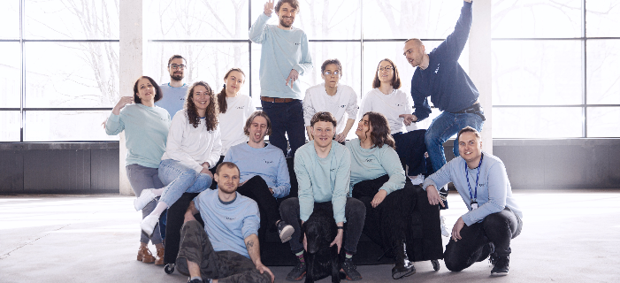



EU HEI SPOTLIGHT
Vilnius TECH Creativity and Innovation Centre “LinkMenų fabrikas
Resembling the wheel of time, the Portal is a large circle which is connected to another Portal in Lublin. Staff and students from Vilnius Tech worked on the project, some for design, some for construction, some for marketing etc. Engineers from the Vilnius Tech creativity and innovation centre LinkMenų Fabrikas built the Portal.
Learn more about the Portal Project

Slide 31
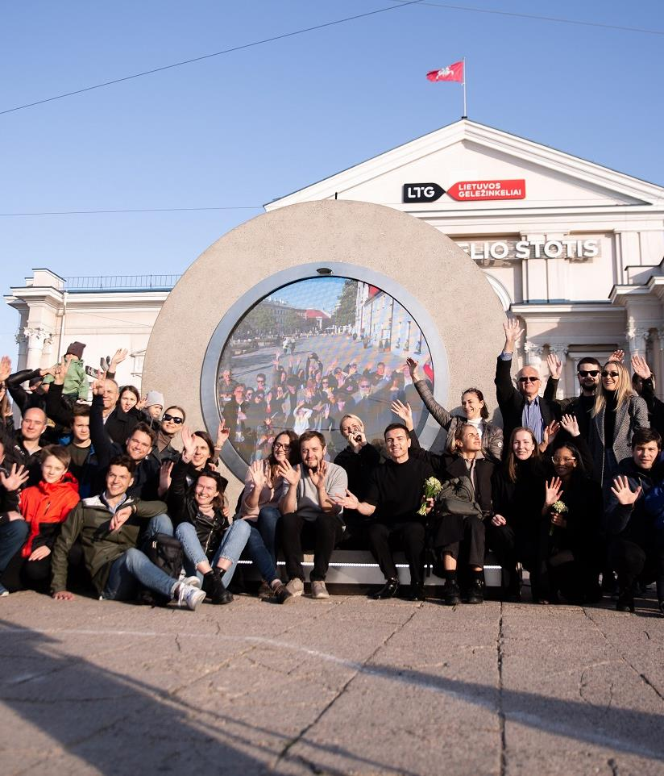
EU HEI SPOTLIGHT
Vilnius Tech feel very strongly that students must learn by doing and must learn to work in teams, especially multidiscipline teams. The main learning outcome for the students who participated was the experience gained from working on a real market project, real communication with business… learning by doing. The students learned how to use technology to bring people together. Students learned digital design, they were involved in the design of each piece. They gained insights into the digital media element, for example how to make the screen work during the day and also during the night. All of the students learned about digital marketing in this project. The project received global recognition and was picked up and featured by BBC News. In terms of digital learning, because of COVID nearly all of the meetings for the project were held online. This gave students and staff a real taste of remote, multidiscipline work and project management.

Slide 32

Spotlight on Collaborative Teaching Strategies
3. Cross-Disciplinary Problem-Solving Sessions: Organise sessions where students are presented with a problem that requires knowledge from various STEM disciplines to solve.
Facilitators from each discipline guide students in applying concepts and methods from their areas of expertise, encouraging cross-disciplinary thinking and collaboration.

Slide 33
Living Labs as Interdisciplinary Teaching Platforms
Living Labs represent a cutting-edge approach to interdisciplinary learning in STEM education, blending the acquisition of 21st-century skills (21CS) with real-world application. Characterised by their dynamic, user-centered environments, Living Labs facilitate innovation and learning by involving students directly in the research, development, and testing phases of projects that address societal needs.
These labs transcend traditional classroom boundaries, offering a participatory platform where students, faculty, industry professionals, and community members collaborate to co-create solutions.

Slide 34
Living Labs as Interdisciplinary Teaching Platforms
In a Living Lab, students from various STEM disciplines come together to tackle challenges that demand a broad spectrum of skills—from environmental science and engineering to data analysis and technology design. For example, a Living Lab focused on urban sustainability might engage students in projects like designing green infrastructure, developing smart city technologies, or analysing data to optimize resource use.
Through these projects, students not only apply their disciplinary knowledge but also develop essential 21CS, including critical thinking, as they evaluate different sustainability models; collaboration, as they work in multidisciplinary teams; and communication, as they present their findings to stakeholders.

Slide 35
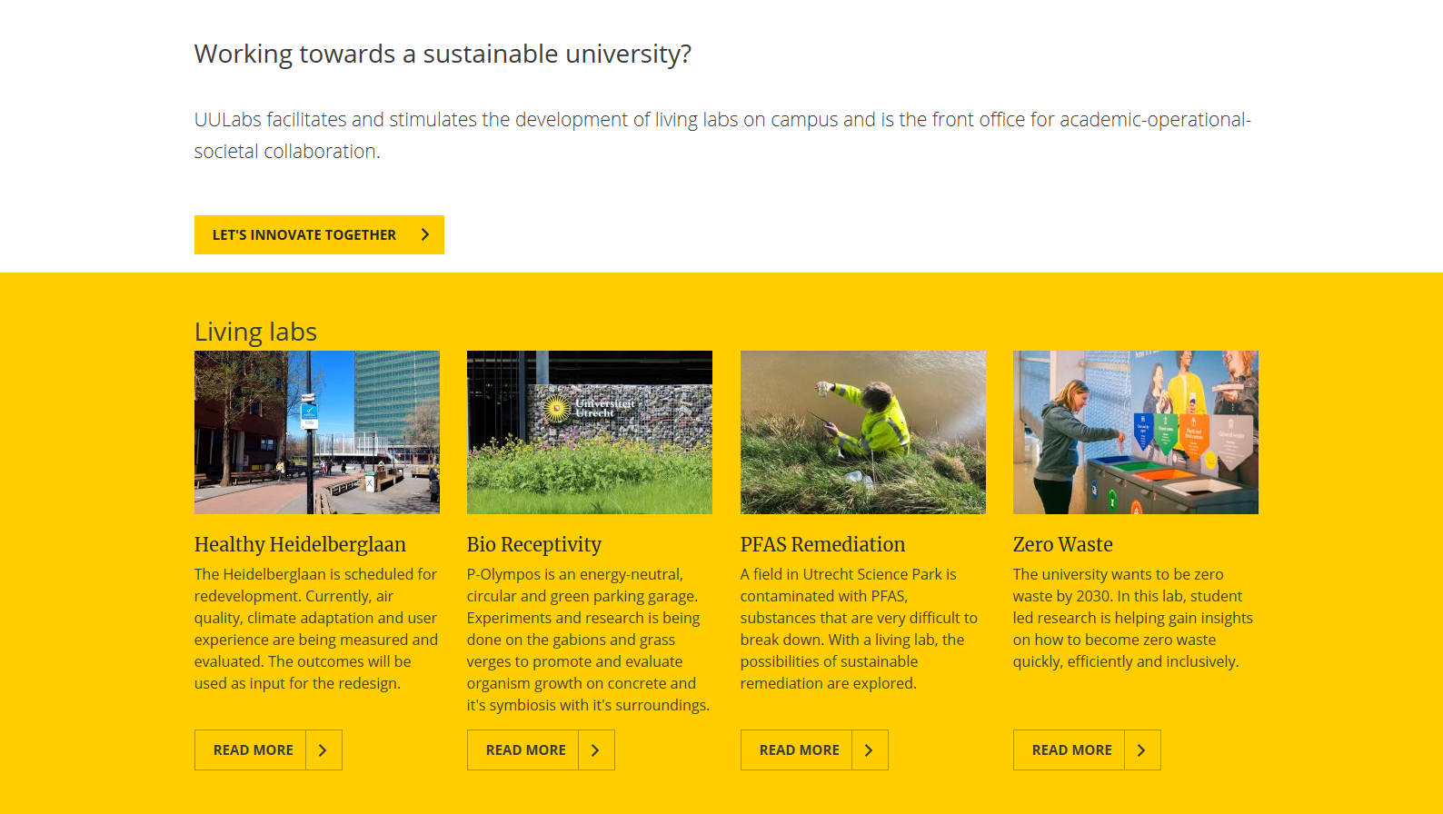
EU HEI SPOTLIGHT ON UTRECHT UNIVERSITY - UULabs
Find out more

Slide 36

Leveraging Technology for Curriculum Integration
04
36

Slide 37

Embracing Digital Tools for 21CS Enhancement
The integration of digital tools into the curriculum can aid the development of 21st-century skills (21CS) across all disciplines. Leveraging technology in education not only enhances traditional learning methods but also introduces students to the digital competencies essential in today's workforce. Digital tools like interactive VR simulations and coding platforms, particularly useful in STEM education, can foster logical thinking and creativity provide dynamic, engaging ways to learn complex concepts and solve problems.
This Photo by Unknown Author is licensed under CC BY

Slide 38
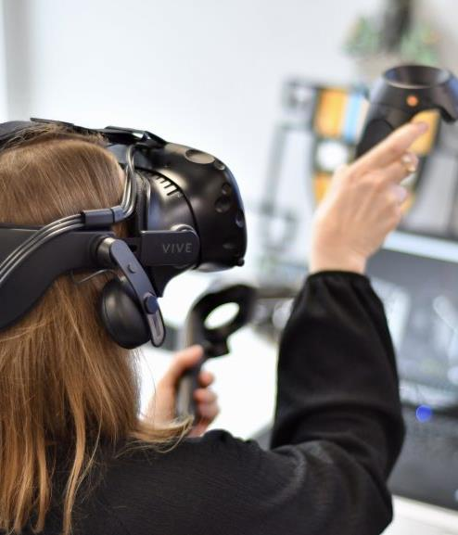
Spotlight on Virtual VR Learning Environments
By simulating real-world environments and complex scenarios, VR can provide a unique platform for students to explore, experiment, and engage with learning content and topics in a deeply personal and impactful way.
VR technology is particularly potent in STEM education, where abstract concepts can be visualised and experienced firsthand, fostering a deeper understanding and retention of knowledge. From conducting virtual lab experiments in science to exploring engineering principles through simulated constructions, VR in learning not only enhances the acquisition of 21st-century skills (21CS) such as critical thinking and problem-solving but also cultivates digital literacy and technological fluency
This Photo by Unknown Author is licensed under CC BY-SA

Slide 39
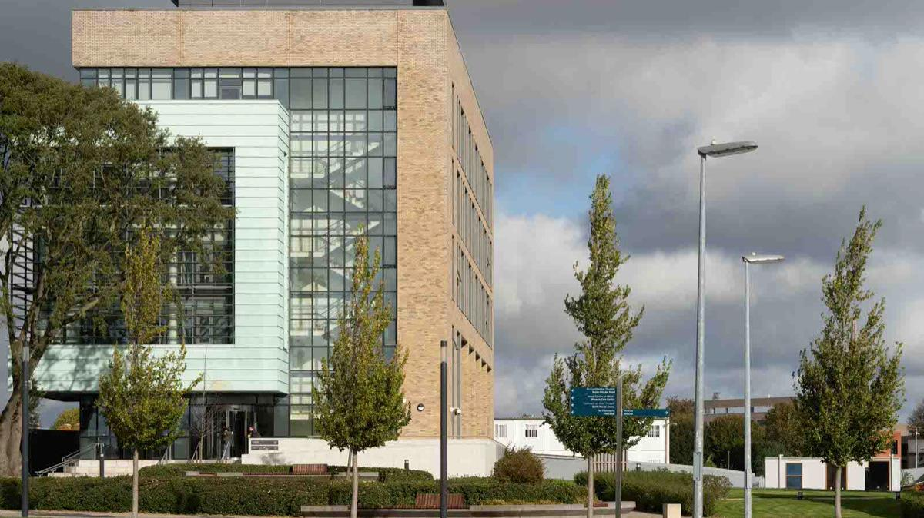
EU HEI SPOTLIGHT ON
TU Dublin selected to deliver training in VR through Bodyswaps and Meta Immersive Learning grant
TU Dublin is one of eight Irish HEIs successful to get a grant for Bodyswaps, together with Meta Immersive Learning, to participate in their Immersive Learning Pilot Programme. The programme aims to allow wider access to immersive learning technologies in education and supports students in gaining the necessary soft skills needed to compete and stand out in a global job market.
Read more

Slide 40
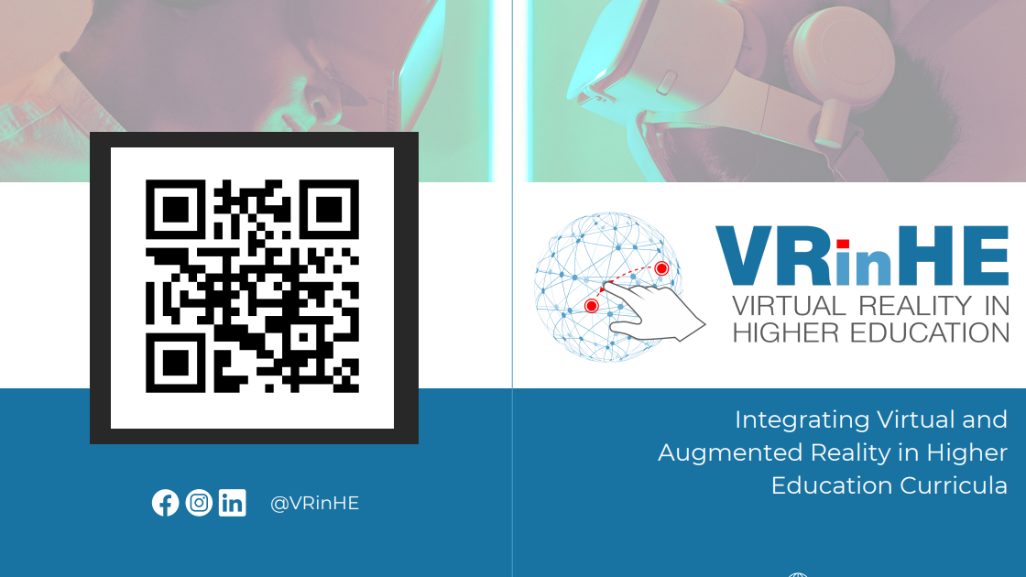
Skills for Educators:
EU HEI Learning Resource – scan QR

Slide 41
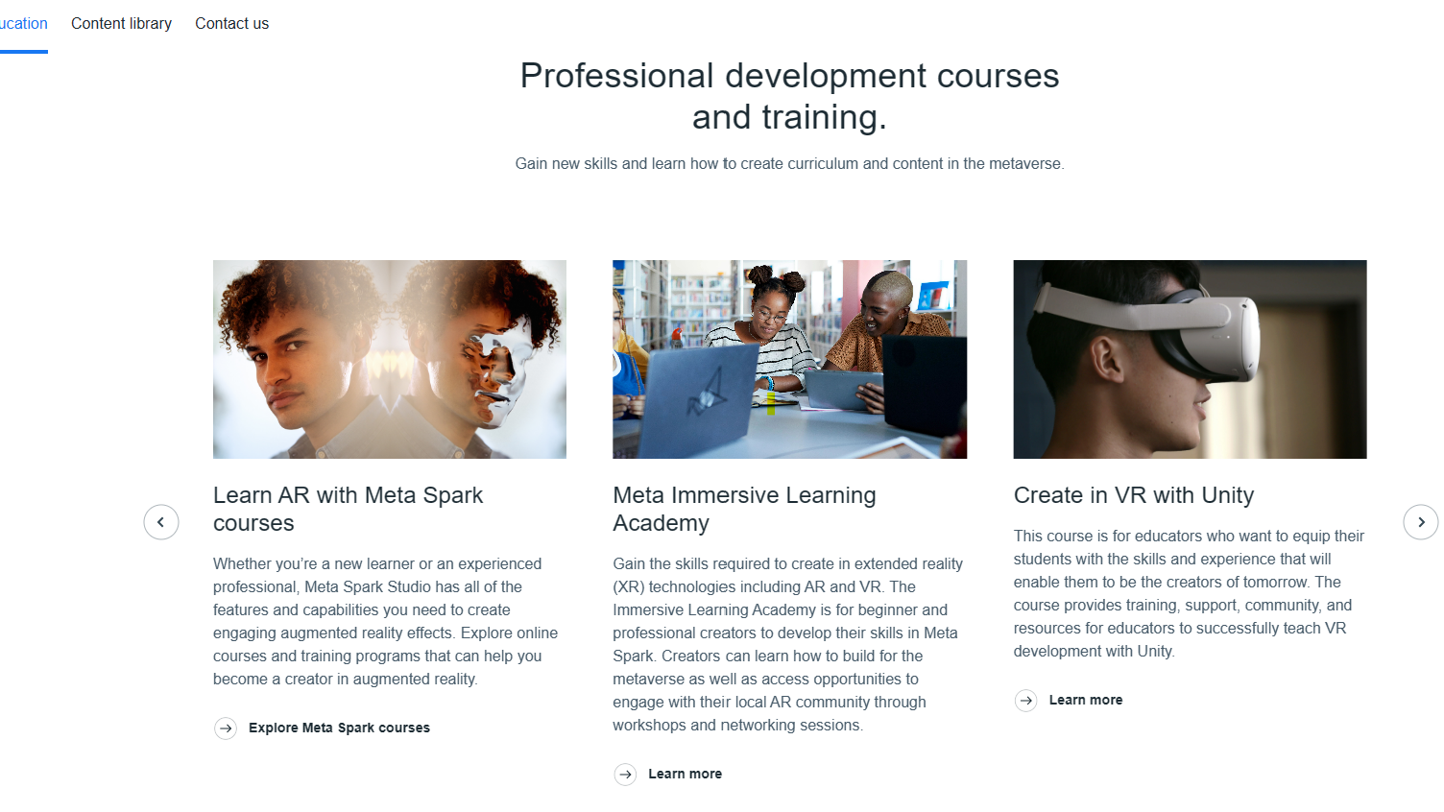

Skills for Educators:
HEI Learning Resource – Meta Learning
https://about.meta.com/immersive-learning/

Slide 42

Spotlight on Virtual Labs
Virtual labs allow students to conduct scientific experiments in a safe, controlled, online environment, breaking down geographical and financial barriers to advanced educational resources.

Slide 43
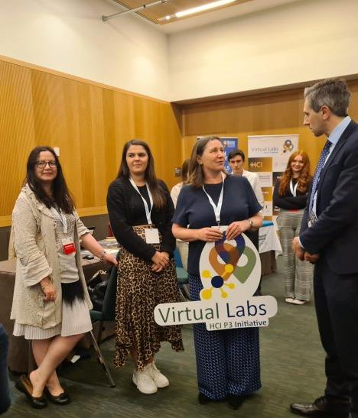
Virtual Labs HCI P3 Initiative
EU HEI SPOTLIGHT ON
This initiative brings 5 Irish Universities together to work on an innovative project focused on the use of virtual laboratories as a teaching tool for the chemical sciences.
The mission is to develop work ready graduates with enhanced practical, project management, communication and team working skills through design of an agile and responsive curriculum where students are afforded the opportunity to experience a real-work environment through virtual training and engagement with enterprise partners and industrially relevant workplace problems.
This ambitious venture, with enterprise partners and education technology providers will involve up to 5,000 students across the five partner higher education institutes over its lifetime.
Learn More

Slide 44
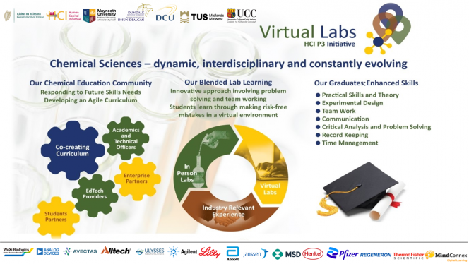
EU HEI SPOTLIGHT ON

Slide 45
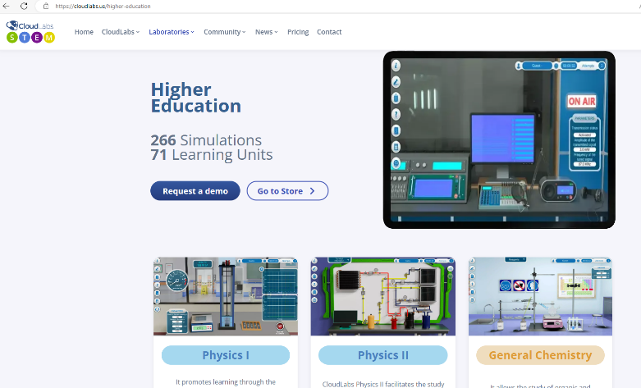
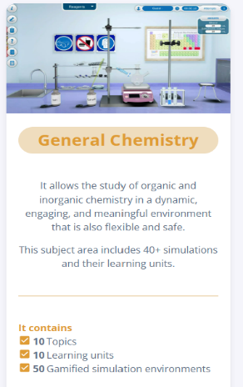

VIRTUAL LEARNING TOOLS FOR EXPLORATION
CloudLabs Virtual STEM
CloudLabs Virtual STEM, is an educational platform centered on the STEM model, featuring over 600 simulations in fields such as physics, chemistry, biology, and mathematics, as well as vocational areas like agriculture, automation, industrial, technology, and electrical networks. It currently has 266 Simulations and 71 Learning Units
https://cloudlabs.us

Slide 46
Other key tools and platforms:
Digital platforms like virtual labs, coding sandboxes, and collaborative online workspaces transform the learning experience, making it more interactive and accessible.
Coding platforms such as Scratch or GitHub Classroom engage students in creating, sharing, and collaborating on software projects, enhancing their digital literacy and problem-solving skills.
Tools such as TED-Ed, National Geographic Education, and PBS LearningMedia provide engaging, high-quality content that can bring subjects to life, sparking students' interest and inspiring further exploration.
By thoughtfully selecting and incorporating these technologies into your curriculum, educators can offer students a rich, varied educational experience that prepares them for the challenges and opportunities of the digital age.

Slide 47

Professional Development and Continuous Learning
05
47

Slide 48
The need for Continuous Professional Development
As we have been uncovering, in this swiftly evolving educational landscape, the need for us as educators to pursue continuous professional development (CPD) has never been more crucial.
A dedication to lifelong learning ensures that, we as educators, we remain at the forefront of pedagogical innovation, technological advancements, and the latest strategies in 21st-century skills (21CS) education.
Embracing CPD enhances personal expertise and enriches the educational experience for our students and better preparing them to navigate and succeed in a complex, digital world.

Slide 49

Reflective learning and foresight:
How can you, as an educator identify the most impactful CPD opportunities in the realm of 21CS?
For discussion – in what ways does ongoing professional development influence student outcomes and educational innovation?

Slide 50
Cultivating a Community of Practice
The establishment of a community of practice among educators acts as a catalyst for shared learning and the exchange of innovative teaching strategies.
Such communities encourage collaboration, discussion, and the sharing of experiences and resources related to the integration of 21CS in education.
Within these communities, educators can find support, inspiration, and a sense of belonging, all of which are invaluable for personal and professional development.

Slide 51

Reflective learning and foresight:
What are the key benefits of participating in a community of practice for educators focusing on 21CS?
How can we as educators initiate or become actively involved in such communities to maximize our professional development?

Slide 52
Navigating Resources for 21CS Enhancement
The journey towards integrating 21CS into teaching practices is supported by an array of resources, from online professional courses and webinars to interactive workshops and educational conferences.
These resources provide educators with insights into effective 21CS teaching methodologies, offering strategies to embed critical thinking, creativity, and digital literacy within the curriculum.
Identifying and utilising these resources is pivotal for educators aiming to cultivate a learning environment that is both dynamic and relevant.

Slide 53

Reflective learning and foresight:
Which resources offer the most value for educators seeking to enhance their 21CS teaching skills?
How can we as educators effectively incorporate new learning from these resources into their existing teaching practices? How open or flexible are our curricula to allow for this?

Slide 54
Our next Module turns the focus to our students and innovative pedagogical practices.
BE 21 SKILLED TEACHER EMPOWERMENT PROGRAM
MODULE 6
Elevate 21CS in STEM Teaching
www.be21skilled.eu

Slide 55
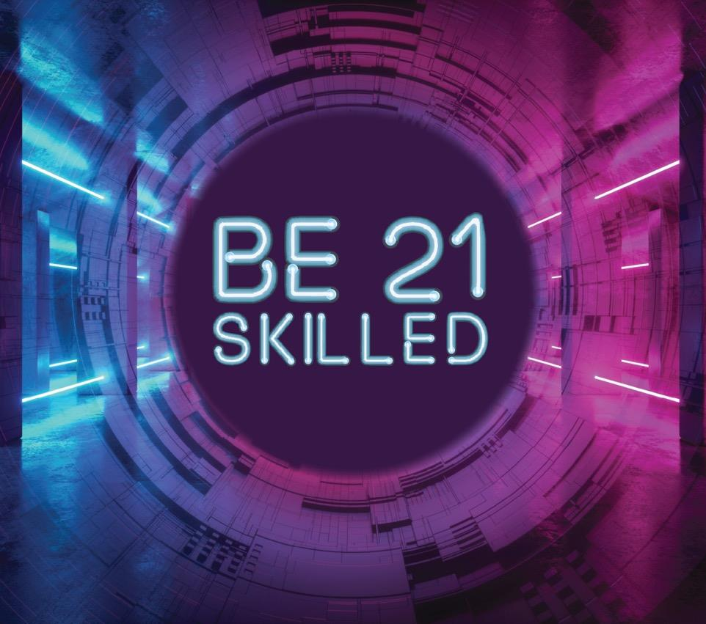


Follow our journey here
www.be21skilled.eu
55

