Slide 1

BE 21 SKILLED TEACHER EMPOWERMENT PROGRAM
MODULE 4
www.be21skilled.eu
INNOVATIVE PEDAGOGICAL PRACTICES TO BOOST THE RELEVANT 21CS IN STUDENTS

Slide 2

TABLES OF CONTENTS
Module 4 Introduction
01
Introduction to Innovative Pedagogical Practices
02
Strategies for Fostering Critical Thinking and Problem-Solving
03
Enhancing Creativity and Innovation in the Classroom
04
Promoting Collaboration, Communication and Engagement
05
Assessment, Feedback and Evolving Curriculum Development for 21CS
This work is licensed under a Creative Commons Attribution-Non-Commercial-No Derivatives 4.0 International License (CC BY-NC-4.0) International License.
Project number: 2021-1-LV01-KA220-HED-000027581

Slide 3
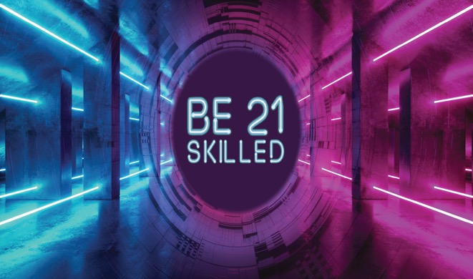
INTRODUCTION By completing Module 4, our educators will acquire learning in 4 key competencies :
Instructional Innovation: Educators will gain the ability to design and implement innovative instructional strategies that foster 21st-century skills (21CS). They will become proficient in integrating pedagogical practices such as problem-based learning, inquiry-based learning, and design thinking into their curriculum.
Collaborative Facilitation: Educators will gain insights how to effectively facilitate collaboration among students, promoting a classroom culture that values teamwork, peer learning, and collective problem-solving.
Technological Proficiency: Module 4 will encourage educators to leverage digital tools and online resources to enrich the learning experience, helping them become adept at incorporating technology in a manner that is pedagogically sound and aligned with learning objectives.
Reflective and Responsive Teaching: The module will cultivate educators' skills in reflective practice, enabling them to assess the effectiveness of their teaching strategies and make informed adjustments to their instructional approaches
3

Slide 4

“To teach is to learn twice.” - Joseph Joubert.

Slide 5

Introduction to Innovative Pedagogical Practices
Innovative pedagogical practices encompass a range of teaching strategies and methodologies that go beyond traditional lecture-based instruction to engage students more effectively and foster the development of 21st-century skills (21CS).
These skills, including critical thinking, problem-solving, collaboration, communication, and creativity, are increasingly recognized as essential for success in the global economy and society.
Innovative pedagogies leverage student-centered approaches, technology, and real-world problem-solving to prepare students for the challenges and opportunities of the future.
01
5

Slide 6
The Need for Innovative Pedagogies for 21CS
The rapid evolution of technology, globalization, and shifts in economic structures from industrial to knowledge-based economies have made 21CS indispensable. Today's students need to be adaptable, innovative, and capable of continuous learning to navigate complex, multicultural environments and unforeseen challenges.
Our traditional education models which have focused primarily on content knowledge, are insufficient for this task. Updating our teaching and incorporating innovative pedagogies is an effective way of equipping students with both the hard and soft skills required in the 21st century.

Slide 7

Defining Innovative 21CS Pedagogies
Innovative pedagogies are characterised by their focus on the learner's active engagement, the integration of technology in meaningful ways, and the alignment of educational experiences with real-world contexts. These approaches often involve problem-based learning, project-based learning, and inquiry-based learning strategies helping students to not only acquire knowledge but also to apply it in innovative and practical ways.

Slide 8





Pedagogical Trends Reshaping 21CS Education
Technology Integration
The use of digital tools and resources to enhance learning experiences and outcomes.
Student-Centered Learning
No longer solely teacher-led instruction, students take an active role in their learning.
Collaborative Learning Students work in diverse groups or teams, to solve problems and complete projects.
Flipped Classroom Allowing for more interactive and application-based learning during class time.
Gamification and Interactive Learning Applying game-design elements to increase engagement and motivation.
We will look at these in a little more detail as we move through this module

Slide 9
Strategies for Fostering Critical Thinking and Problem-Solving
In today's rapidly evolving world, critical thinking and problem-solving skills are essential tools for personal and professional success. As we prepare students for the uncertainties of the future, fostering these skills becomes a priority for educators across disciplines. Critical thinking involves the ability to analyse information and arguments, identify assumptions, evaluate evidence, and construct reasoned conclusions. Problem-solving, on the other hand, is the process of identifying complex issues and implementing effective solutions.
Together, these skills empower students to navigate the complexities of the modern world with confidence and creativity. Innovative pedagogical strategies, such as Problem-Based Learning (PBL) and Inquiry-Based Learning (IBL), are at the forefront of this educational shift, providing frameworks that encourage students to question, analyse, and solve real-world problems. By integrating these approaches into the curriculum, educators can create a dynamic learning environment that not only imparts knowledge but also cultivates the critical and analytical mindset essential for the 21st century.
02
9

Slide 10

Problem-Based Learning (PBL) - Overview
Problem-Based Learning (PBL) is a student-centered pedagogy in which students learn about a subject through the experience of solving an open-ended problem. This method encourages learning in context, critical thinking, and the application of knowledge to real-world scenarios. PBL involves students working in groups to solve challenges that do not have a single correct answer, thereby promoting discussion, collaboration, and the development of problem-solving skills.

Slide 11
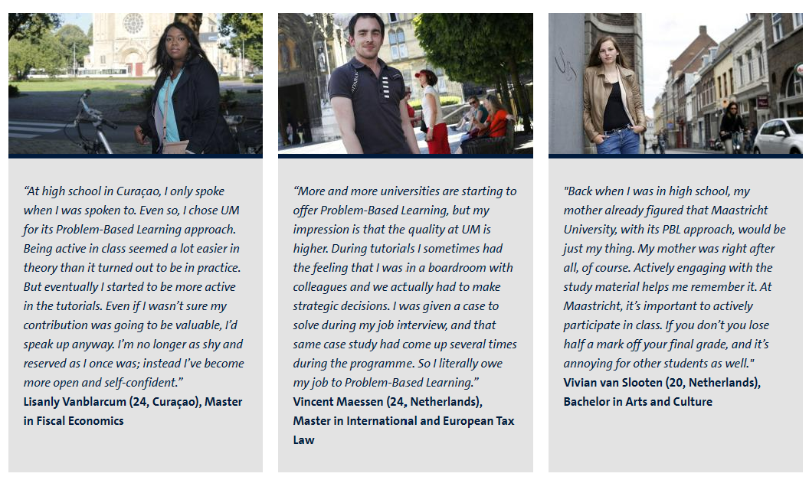
EU HEI SPOTLIGHT ON
University of Maastrict: PBL is a favoured approach for students
Problem-Based Learning - Education - Maastricht University

Slide 12
Introduce a Complex Problem: Present students with a problem that is relevant, challenging, and requires no single, straightforward solution.
Group Collaboration: Organise students into small groups to encourage collaboration and the sharing of diverse ideas and approaches.
Research and Inquiry: Guide students as they research and gather information necessary to address the problem.
Solution Development: Facilitate the development of solutions, encouraging students to apply their knowledge and think critically.
Presentation and Reflection: Have students present their solutions, fostering a reflective discussion on the problem-solving process and the learning that occurred.
How to bring PBL into your teaching:

Slide 13

Enquiry-Based Learning (EBL) - Principles and Benefits
Enquiry-Based Learning (EBL) is a pedagogical approach that places students at the center of their learning process, encouraging them to ask questions, conduct investigations, and explore solutions. The core principle of EBL is to stimulate curiosity and inspire a deeper understanding of the subject matter. Benefits of EBL include enhanced engagement, improved critical thinking and research skills, and the ability to apply knowledge in practical and meaningful ways.

Slide 14
Start with a Question: Pose an open-ended question that sparks curiosity and is relevant to the curriculum.
Research and Investigation: Encourage students to undertake independent or group research to explore the question from multiple angles.
Critical Analysis: Guide students in critically analysing the information they have gathered, evaluating sources, and identifying biases.
Developing Solutions/Responses: Support students in developing well-reasoned responses or solutions to the initial question.
Reflection and Discussion: Conclude with a reflective discussion or presentation where students share their findings, reflecting on the process and what they have learned.
To foster critical thinking and problem-solving through EBL:

Slide 15
Enhancing Creativity and Innovation in the Classroom
As educators, we are tasked with preparing students not just to solve existing problems but to envision and create what has never been before.
This requires a learning environment that fosters creativity and innovation at its core. Two transformative approaches to nurturing these skills are
the integration of Design Thinking as a pedagogical strategy and
the incorporation of maker spaces and creativity labs (e.g. The LEGO Lab at Riga Technical University (RTU) is an exciting initiative that combines creativity, innovation, and education. RTU hosts a Design Factory, which is part of the Design Factory Global Network. Established in 2016, it encourages innovative thinking, creativity, and entrepreneurial skills among students. The “theLAB” within the Design Factory provides an open-type workshop where students can experiment, create, and collaborate. It’s a space where ideas come to life, fuelled by imagination and hands-on exploration.
03
15

Slide 16

  UniLab is part of RTU’s Science and Innovation Centre, Science and Innovation Centre | Riga Technical University (rtu.lv) aims to promote science-intensive business ideas.
  It supports the development of high-value-added products by combining intellectual and technical resources.
  UniLab encourages students to explore their entrepreneurial potential and turn innovative concepts into reality².
These initiatives at RTU demonstrate a commitment to nurturing creativity, fostering collaboration, and driving real-world impact. Whether through LEGO bricks or cutting-edge technology, RTU strives to inspire the next generation of innovators.

Slide 17
Design Thinking as a Pedagogical Strategy
Design Thinking is a solution-focused, user-centered approach to problem solving that encourages students to think deeply about the needs of those they are designing for, redefine problems in an attempt to identify alternative strategies and solutions that might not be instantly apparent with our initial level of understanding.
As a pedagogical strategy, Design Thinking involves five phases:
Empathise: Understand the needs of the users or beneficiaries.
Define: Clearly articulate the problem to be solved.
Ideate: Brainstorm a wide range of creative solutions.
Prototype: Build a representation of one or more of your ideas to show to others.
Test: Return to your original user group and testing your ideas for feedback.

Slide 18
Implementing Design Thinking in Education
There are three core elements involved in Implementing Design Thinking in a HEI classroom:
Fostering an Environment of Collaboration Encouraging teamwork and the sharing of diverse ideas and perspectives
Encouraging Iterative Learning
Teaching students that failure is part of the learning process and that solutions can be improved upon with feedback.
Integrating Real-World Problems Using real-world challenges to apply the design thinking process, making learning more relevant and impactful

Slide 19
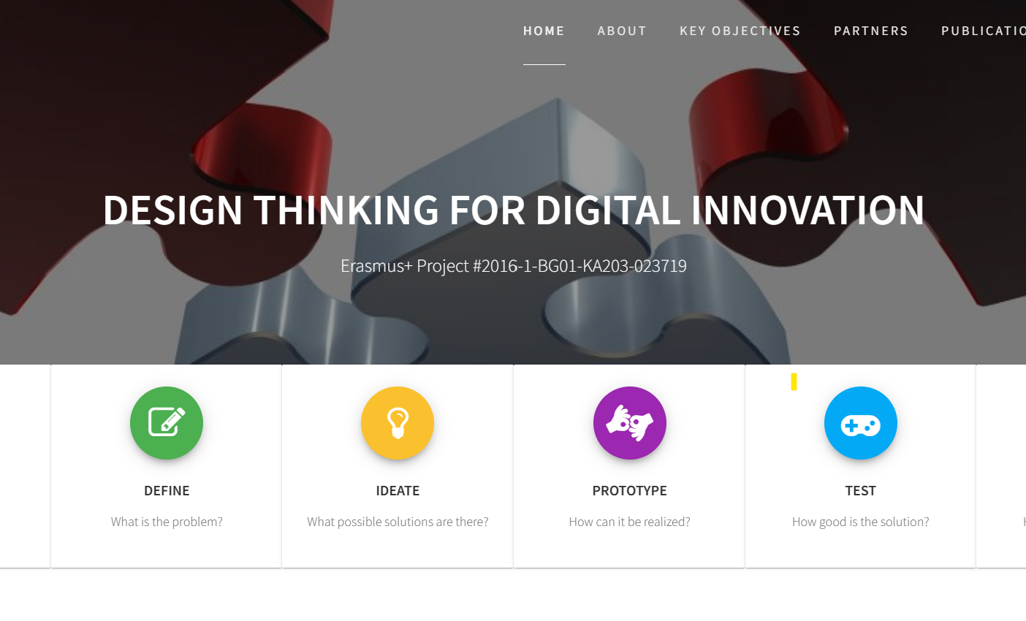
EU HEI SPOTLIGHT ON
University of Library Studies and Information Technologies (ULSIT), Bulgaria
ULSIT is a leader in applying Design Thinking in Computer Science and Information Technologies education. It spearheaded the European Erasmus+ project "Design Thinking for Digital Innovation" to develop a comprehensive course in Design Thinking, demonstrating its commitment to innovative education​
DigiThink – Erasmus+ Project #2016-1-BG01-KA203-023719 (unibit.bg)

Slide 20

Maker Spaces and Creativity Labs
Maker spaces and creativity labs are physical or virtual environments where students can come together to explore, tinker, invent, and create. These spaces are equipped with tools and materials that encourage experimentation across a wide range of activities, from coding and robotics to woodworking and craft. The provide tools and resources that are accessible to all students, regardless of their skill level.
They encourage collaboration among students, with spaces designed to facilitate group projects and peer learning. They support students in pursuing their own creative projects, fostering a culture of innovation and entrepreneurial thinking.

Slide 21


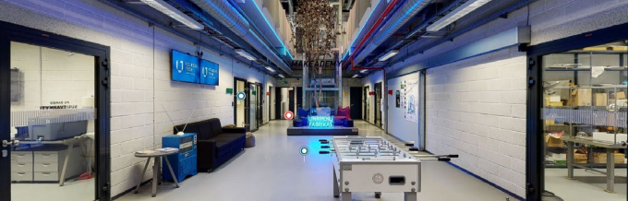

EU HEI SPOTLIGHT ON
Vilnius TECH Creativity and Innovation Centre “LinkMenų fabrikas
connects students, developers, researchers, engineers and business developers. It provides tools, spaces and know how for students willing to bring their dreams into the real world. It helps students grow, find new connections and encourage creativity and self-expression
Learn more

Slide 22
Enhances Engagement: Hands-on activities increase student engagement and interest in learning.
Develops Problem-Solving Skills: Working on projects in these spaces requires students to apply critical thinking and problem-solving skills.
Fosters Independence and Confidence: Completing projects from start to finish builds independence, resilience, and confidence in students.
Promotes Cross-Disciplinary Learning: These environments encourage the integration of knowledge and skills from various disciplines, highlighting the interconnectedness of different fields of study.
Benefits of Maker Spaces and Creativity Labs

Slide 23
Promoting Collaboration, Communication and Engagement
In an increasingly interconnected world, the ability to collaborate and communicate effectively is more important than ever. The 21st century classroom needs to reflect this reality by embedding these skills into the learning process.
This section explores innovative pedagogical strategies that emphasise and enhance collaboration and communication among students. Specifically, we will delve into the benefits and methodologies of peer teaching and collaboration, as well as the flipped classroom model, and how these approaches can transform the learning experience. We also explore gamification and how it encourages learners to engage with learning content in an active, hands-on manner.
We aim to equip educators with the tools to nurture a generation of learners who are not only knowledgeable but also adept at navigating the complexities of communication and collaboration in their future careers and communities.
04
23

Slide 24

Peer Teaching and Collaboration
Peer teaching is an educational practice in which students teach other students. This method leverages the diverse backgrounds, skills, and understandings of learners within a classroom, fostering a collaborative learning environment. The benefits of peer teaching include:
Enhanced Learning Retention - Teaching material to peers requires a deep understanding of the subject, which enhances retention and comprehension.
Improved Social Skills - Students develop their communication and interpersonal skills through direct interaction.
Increased Engagement and Motivation - Learners are often more engaged and motivated when interacting with peers.

Slide 25
Peer teaching and collaborative learning is grounded in the belief that educational experiences become deeper and more meaningful when they are active, social, contextual, engaging, and student-owned.
Peer teaching and collaborative learning methods are based on the premise that students can benefit from the knowledge and perspectives of their peers, creating a more dynamic and engaging learning environment.
This approach is particularly relevant in today’s evolving 21st century educational landscape, where the development of interpersonal skills and the ability to work effectively in teams are highly valued.
By fostering an environment where students actively participate in their own learning process through collaboration and peer-to-peer instruction, these methods not only enhance knowledge acquisition but also develop essential 21CS skills that are crucial in the modern educational and professional landscape.
25

Slide 26
Methodologies of Peer Teaching
Implementing effective peer teaching involves:
Structured Peer Teaching Sessions and designing sessions where students can take on the role of the teacher in small groups or pairs.
Training Students in Effective Communication, teaching them how to explain concepts clearly and listen actively.
Providing Supportive Resources and offering materials and guidance to help student-teachers prepare their lessons.
Feedback Mechanisms to establish methods for both teachers and peers to provide constructive feedback on teaching and understanding.

Slide 27
THE POWER OF A FLIPPED CLASSROOM
A flipped classroom is a pedagogical approach where traditional learning models are inverted. Instead of introducing new content in class, students first encounter new material outside of class, typically through video lectures or reading assignments. Class time is then used for activities that deepen understanding through discussion, problem-solving, or practical application.
Flipped classroom lessons and approaches are designed to be fluid/flexible. Introducing the concept outside of the classroom (typically as homework) allows learners to explore new content and learning material at their own pace. Video lessons are a mainstay of a flipped classroom given that they can be rewatched multiple times until the learner has a good grasp of the content.
The flipped classroom approach is especially effective for developing skills relevant to the 21st century. It primarily boosts active learning by prompting students to immerse themselves in the material, thereby sharpening their critical thinking and problem-solving abilities, which are needed to stay ahead in today’s workplace.
27

Slide 28
ADVANTAGES OF A FLIPPED CLASSROOM
The flipped classroom model offers several advantages, particularly in developing 21st-century skills. One of its primary benefits is the increase of active learning. This approach encourages students to engage deeply with material, promoting critical thinking and problem-solving skills.
Another significant advantage of the flipped classroom is developing self-directed learning habits. By engaging with new material independently outside of the classroom, students learn to take initiative and control over their learning process. This autonomy is a key skill for lifelong learning, a vital attribute in the 21st century where continuous skill development is necessary for career longevity. This ability to self-direct is increasingly important in a world where individuals are expected to adapt and grow throughout their careers continually.
Similarly, the flipped classroom model is conducive to improving collaboration skills. Class time is often used for collaborative activities, enhancing students' ability to work in teams and communicate effectively. Modern workplaces value teamwork and interdisciplinary cooperation. The model's interactive nature increases student engagement and motivation, fostering a more profound love for learning and curiosity, which are critical components of adaptability and creativity in professional contexts.
28

Slide 29

ADVANTAGES OF A FLIPPED CLASSROOM
The flipped classroom model can also improve collaboration skills. Class time is often used for collaborative activities, enhancing students' ability to work in teams and communicate effectively.
The model's interactive nature increases student engagement and motivation, fostering a more profound love for learning and curiosity, which are critical components of adaptability and creativity in professional contexts.
Finally, the flipped classroom customises the learning experience. Students can learn at their own pace during out-of-class activities, allowing for a more personalized approach that caters to different learning styles.
The model integrates digital tools effectively, equipping students with digital literacy skills important in almost all professional fields today.
29

Slide 30
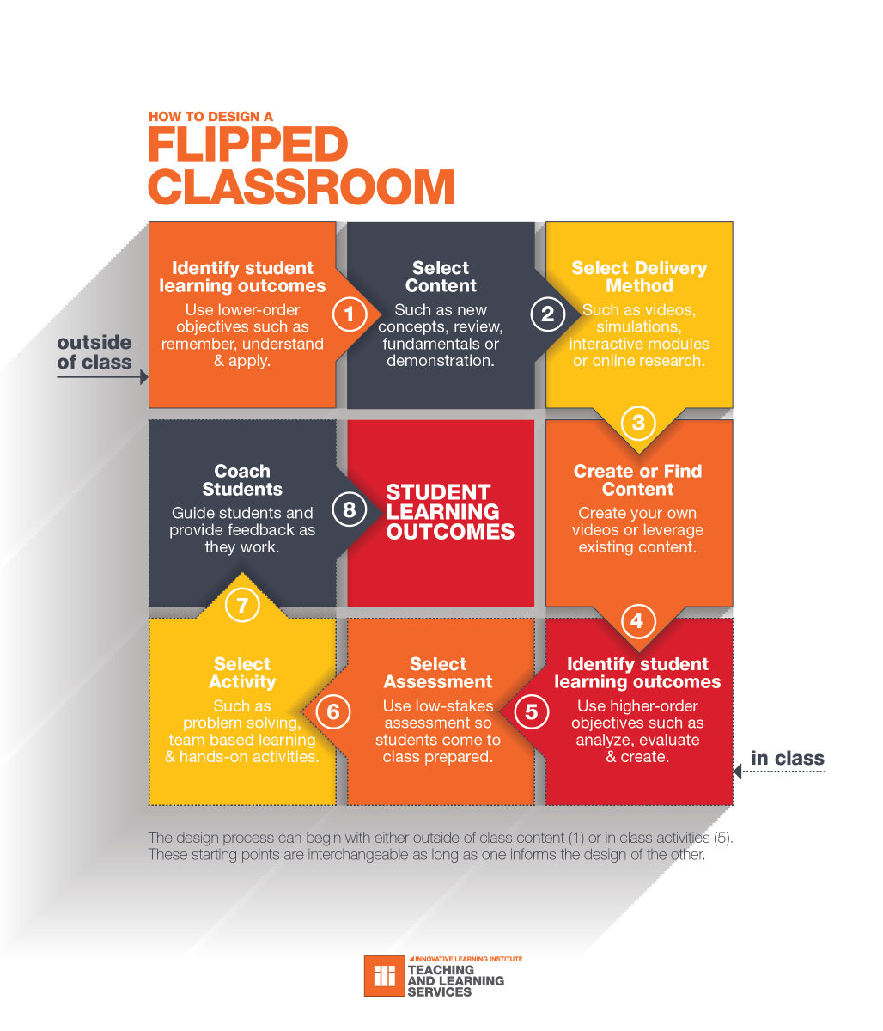
HOW TO PLAN A FLIPPED CLASSROOM
This infographic illustrates the following key steps to optimise learning outcomes:
Begin by determining what students should be able to know or do by the end of the course.
Choose material that is relevant and engaging, providing a solid foundation for in-class activities.
Decide on the most effective way to deliver out-of-class content.
Develop your own materials or curate existing resources that best fit the course objectives.
Incorporate low-stakes assessments to ensure students come to class prepared.
Design engaging, hands-on activities for class time that build on the pre-class content.
Use feedback and assessment results to refine the flipped classroom experience continually.
Source

Slide 31
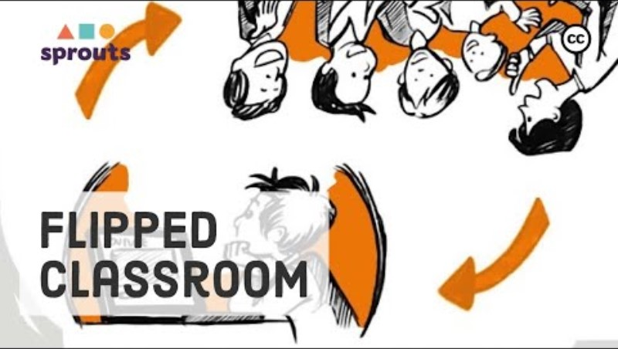
WATCH- FLIPPED CLASSROOM IN ACTION
Click on the video link on the image or below for an example of how you can implement a flipped classroom.
https://www.youtube.com/watch?v=qdKzSq_t8k8

Slide 32
INTRODUCTION TO GAMIFICATION IN LEARNING
Gamification in learning introduces game elements into educational environments to motivate and increase student engagement. This method transforms the learning process by incorporating challenges, levels, and rewards, similar to those found in games, which can significantly enhance motivation and participation.
Gamification taps into the natural human desire for competition and achievement. By embedding elements commonly found in games, such as point scoring, competition, and rules of play, it encourages learners to engage with the material in an active, hands-on manner. Gamification makes the acquisition of new knowledge and skills an interactive and enjoyable experience.
Gamification in education tailors the learning experience to be dynamic and interactive. Digital badges, leaderboards, and avatars are common features of gamified learning, offering a familiar and stimulating environment that rewards progression and mastery.
32

Slide 33
Advantages of gamification in learning
Gamification in education tailors the learning experience to be dynamic and interactive. Digital badges, leaderboards, and avatars are common features of gamified learning, offering a familiar and stimulating environment that rewards progression and mastery. This approach allows learners to interact with new concepts and apply knowledge through game-like scenarios, which can be revisited and played numerous times, enhancing both understanding and retention of the content.
Other advantages to gamification in learning include:
Real-World Applications and Problem-Solving Skills: Gamification helps learners see the practical applications of their knowledge by simulating real-world scenarios. This approach is effective in developing critical thinking and problem-solving skills, which are crucial in real-life situations
Instant Feedback and Reinforcement: Gamified learning provides immediate feedback, allowing learners to understand their progress and areas for improvement quickly. This instant response mechanism is essential for effective learning and skill development.
33

Slide 34
Advantages of gamification in learning
Data-Driven Insights and Assessment: Gamification in education often comes with analytics and data tracking, providing educators with insights into student performance and areas for improvement. This data-driven approach enables more targeted and effective teaching strategies
Increased Engagement: Gamification makes learning more engaging by incorporating game-like features such as interactive quizzes and immersive simulations. This approach captivates students' attention, making the learning process more enjoyable and less of a passive experience.
Enhancement of Collaboration and Social Interaction Skills: One of the key 21st-century skills is the ability to work collaboratively in diverse teams and communicate effectively. Gamification in education promotes these skills by integrating multiplayer games, group challenges, and leaderboards that develop both competition and cooperation. This environment encourages students to collaborate on projects, share knowledge, and support each other. By engaging in these interactive and social learning activities, students develop essential skills like teamwork, communication, and the ability to negotiate and resolve conflicts.
34

Slide 35

Limitations of gamification in learning
While gamification has shown to be effective in certain contexts, it's important to critically evaluate its implementation to ensure it aligns with educational goals without inadvertently creating issues that could detract from the learning experience. Understanding the potential drawbacks of gamification is essential for educators to create a balanced and effective learning environment that benefits all students.
It is important to look beyond the surface-level excitement of games and consider the deeper implications on students. A nuanced examination of these aspects provides valuable insights into making gamification a more effective and inclusive tool in education.

Slide 36
Limitations of gamification in learning
Risk of Overemphasis on Rewards: One of the main critiques of gamification is that it might place too much emphasis on external rewards like points, badges, and leaderboards. This focus can potentially overshadow the intrinsic value of learning. When the excitement of the game elements fades, students may lose interest in the subject matter itself, or become demotivated if the rewards are not sufficiently appealing or attainable.
Potential for Increased Anxiety and Competition: For some learners, the competitive aspects of gamification can lead to increased stress and anxiety. Not all students thrive in competitive environments; some may feel pressure to outperform others, which can detract from the learning experience. This can be particularly problematic if the gamification elements do not accommodate different skill levels and learning paces.
Accessibility and Equity Concerns: Gamification often relies on digital platforms and technologies that may not be accessible to all students, especially in under-resourced educational environments. This can create disparities in learning opportunities and outcomes, exacerbating existing inequalities. Furthermore, designing high-quality gamified learning experiences can be costly and time-consuming, which may not be feasible for all educational institutions.
36

Slide 37

WATCH- GAMIFICATION IN LEARNING IN ACTION
Click on the video link on the image or below for some ideas on how you can use Gamification with your students
https://www.youtube.com/watch?v=-UXsuofrUdk

Slide 38
Assessment, Feedback and Evolving Curriculum Development for 21CS
Assessment and feedback within the context of 21st-century skills (21CS) necessitate a nuanced approach that goes beyond traditional metrics to evaluate a broader spectrum of student abilities and learning outcomes. With regard to 21CS, feedback becomes a critical dialogue that helps students refine their skills, encouraging a mindset of continuous improvement and resilience in the face of challenges.
Curriculum development for 21CS, meanwhile, demands a proactive and dynamic strategy to stay aligned with technological advancements, societal changes, and the evolving needs of the workforce. Educators must engage in ongoing professional development, collaborate with peers and industry experts, and incorporate current research and educational trends into curriculum planning. This ensures the curriculum remains relevant and effective in equipping students with the skills necessary to succeed in a rapidly changing world
05
38

Slide 39
Assessment and Feedback for 21st Century Skills (21CS)
As we aim to prepare students for a complex world, it is essential to employ innovative assessment methods that can accurately evaluate skills such as critical thinking, creativity, collaboration, and communication. Some interesting assessments mechanisms to consider are:
Performance-Based Assessments which involve students completing a task or project that demonstrates their competence in critical thinking, problem-solving, and other 21CS.
Student Digital Portfolios which are a curated collection of students work, learning and growth in various 21CS areas.
Peer Assessments which allow students to evaluate each other’s work can foster critical analysis and communication skills.
Self-Assessment which encourages students to assess their own work can promote self-reflection and personal growth
06
39

Slide 40

Performance-Based Assessments
Performance-Based Assessments can be used to evaluate students' abilities to apply skills like critical thinking and problem-solving through tasks or projects. For effective implementation in teaching 21CS, we need to consider clear criteria such and determine the desired outcomes, the integration of real-world problems to enhance relevance, and the need to provide structured feedback to guide learners' reflection and growth.
Encouraging collaboration is also important on projects can also foster teamwork skills which are an essential components of 21CS.

Slide 41
Spotlight on Student Digital Portfolios
Digital portfolios are a transformative assessment tool that encapsulates a student’s progress and accomplishments over time. These curated collections represent not just the culmination of learned material but also the evolution of a student’s 21CS.
Through various multimedia elements—such as essays, video projects, and collaborative work—portfolios highlight personal achievements and learning breakthroughs, showcasing individual growth and the mastery of complex concepts.
Working on their student digital portfolios, provides students with a platform for continuous reflection, self-assessment, and demonstrate the student's ability to synthesize and apply knowledge in diverse contexts.

Slide 42

Spotlight on Student Digital Portfolios
Digital portfolios can offer a comprehensive view of a student's abilities, capturing a wide array of skills from critical thinking to creative expression.
Portfolios can include interactive elements, such as presentations or projects, that engage viewers and provide a deeper insight into the student’s competencies
Beyond assessment, digital portfolios serve as a professional development tool, preparing students for career opportunities where digital literacy and self-presentation are key.

Slide 43
Aligning Assessment with Learning Outcomes
As educators, you will already be aware that of the benefits of a well-aligned assessment and how it helps ensure that the learning objectives, instructional activities, and assessment tasks are all in harmony. With regard to 21CS, it is beneficial to consider how your assessments can be used, revised or improved to help students demonstrate their competencies in critical areas such as creativity, collaboration, critical thinking, and communication.
By ensuring your assessments are closely aligned with 21CS learning outcomes, educators can provide students with clear expectations and relevant challenges that truly measure student readiness for the future.
Let’s take a look at a potential 21CS Rubric you could use or adapt:

Slide 44
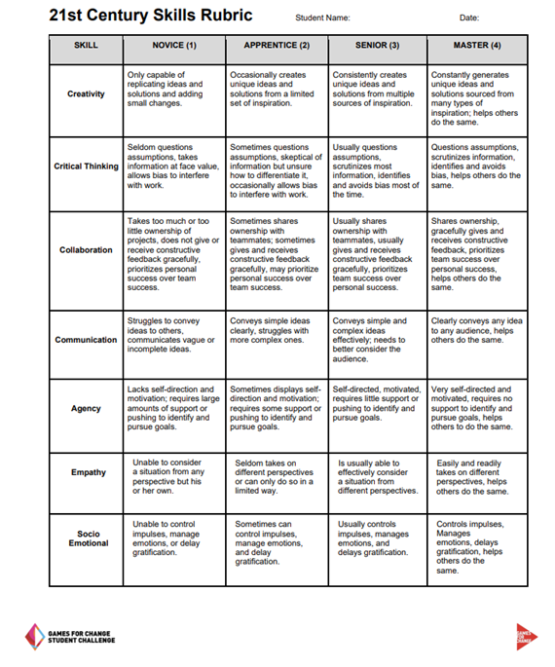
21CS Rubric
This 21st Century Skills Rubric provides a structured framework for assessing students’ progression in key competency areas: Creativity, Critical Thinking, Collaboration, Communication, Agency, Empathy, and Socio-Emotional skills.
Each skill is assessed at four levels of proficiency: Novice, Apprentice, Senior, and Master.
The rubric serves as a comprehensive tool for educators to evaluate and communicate student development in these essential areas
G4C_21CS-Assessment-Toolkit.pdf (gamesforchange.org)

Slide 45
Evolving Curriculum Development
  Curriculum development is not a one-time event but a dynamic process that requires ongoing refinement and adaptation. As we prepare students for a rapidly changing world, it is critical that educational curricula evolve to incorporate innovative pedagogical practices that are responsive to current trends, technological advancements, and the evolving needs of society. This continuous evolution ensures that students are not only knowledgeable but also equipped with the necessary skills to thrive in the future.
  The Importance of a Dynamic Curriculum:
  - A dynamic curriculum prepares students for jobs that may not yet exist, teaching them how to learn, adapt, and apply skills in various contexts.
  - As technology progresses, curricula must integrate new tools and methods to stay relevant and engaging.
  - Updating the curriculum ensures that 21st-century skills are woven throughout, preparing students for the complex problem-solving and critical thinking required in modern careers
45

Slide 46

Visioning the Future in Curriculum Design
  As architects of education, it's our duty to look beyond the immediate horizon and craft curricula that not only respond to the present but also anticipate the demands of the future. This foresight isn't just about predicting technological trends; it's about understanding the evolving landscape of work, culture, and society.
  Our curriculum must be a conduit for 21st-century skills (21CS) like adaptability, innovation, and digital fluency. This future-focused approach requires embedding foresight strategies into curriculum development, proactively incorporating emerging technologies and trends that enhance 21CS, and anticipating societal shifts that demand new forms of literacy.

Slide 47

Key Considerations for you and your colleagues to discuss:
21CS Foresight: How can we stay ahead of educational trends to embed future-critical 21CS proactively?
Emerging Technologies: In what ways can the latest technologies be harnessed to facilitate 21CS like critical thinking and digital literacy?

Slide 48

Inclusivity: The Keystone of 21CS
  True inclusivity in curriculum design ensures that every student not only has a seat at the table but also a voice in the conversation.
  It's about creating a learning environment where diverse perspectives are not just heard but are integral to the learning experience, fostering 21CS such as collaboration and communication.
  An inclusive curriculum speaks to all learning styles, enabling every student to develop these critical skills in a way that resonates with them personally and culturally.

Slide 49

Key Considerations for you and your colleagues to discuss:
Diverse Perspectives and 21CS: How can we ensure that diverse perspectives are integrated in a way that enriches 21CS development?
Adapting to Learning Styles: What approaches can we take to cater to various learning styles while fostering 21CS?

Slide 50

Ethical Awareness: A Pillar of 21CS
  As we integrate technology into our curricula, we must also cultivate an ethical mindset that is essential for the 21st century. It's about teaching students not just how to use technology, but how to use it responsibly, critically, and with consideration for the broader impact on society and the environment.
  Ethical considerations are a core component of 21CS, equipping students with the ability to make decisions that are not only effective but also just and sustainable.

Slide 51

Key Considerations for you and your colleagues to discuss:
Technology and Ethics: How can we embed discussions of ethics in technology within the framework of 21CS?
Sustainable Solutions: In what ways can the curriculum emphasize sustainability as part of a holistic approach to 21CS?

Slide 52
Our next Module turns the focus to our students and innovative pedagogical practices.
BE 21 SKILLED TEACHER EMPOWERMENT PROGRAM
MODULE 5
21CS Integration into the Curriculum
Overview
www.be21skilled.eu

Slide 53



Follow our journey here
www.be21skilled.eu
53

