Slide 1
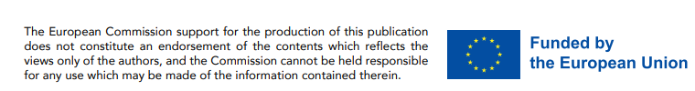
BE 21 SKILLED TEACHER EMPOWERMENT PROGRAM
MODULE 3
www.be21skilled.eu
The Role of Regional Skills Councils and External Collaboration

Slide 2

TABLES OF CONTENTS
Module 3 Introduction
01
What is a Regional Skills Council?
02
Stakeholder Engagement
03
Regional Adaptability
04
Skills Identification and Integration
05
Evolving Curriculum Development
This work is licensed under a Creative Commons Attribution-Non-Commercial-No Derivatives 4.0 International License (CC BY-NC-4.0) International License.
Project number: 2021-1-LV01-KA220-HED-000027581

Slide 3


MODULE 3 INTRODUCTION
Developing 21CS in the context of STEM education cannot happen in a vacuum. Be 21 Skilled, led by RIGAS TEHNISKA UNIVERSITATE in collaboration with UNIVERZITET U BEOGRADU sought to explore their applicability is a region-specific and labour-market context through the multi-stakeholder collaborative efforts of Regional Skill Councils.
In this module, we share the process and learning from establishing Skills Councils in Latvia and Serbia. Educators can apply these learnings to their own contexts, ensuring that the learnings are not only understood but are also practically applied in other European settings.

Slide 4
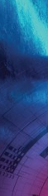
By completing Module 3, our educators will unlock 4 key competencies :
Stakeholder Engagement: Equipping educators with the ability to effectively engage with various stakeholders, including industry partners, government bodies, and community organizations, to collaboratively develop and refine STEM education curricula.
Regional Adaptability: Developing the capacity to adapt STEM education strategies to specific regional and labour market needs, acknowledging the diverse economic and cultural contexts across Europe.
Skills Identification and Integration: Enhancing educators' skills in identifying key 21st-century competencies relevant to their region's labor market and integrating these into the STEM curriculum effectively.
Evolving Curriculum Development: Fostering collaborative skills for educators to work with Skills Councils and other stakeholders in co-creating curricula that are responsive to the evolving needs of students and industries.
4

Slide 5

WHAT IS A REGIONAL SKILLS COUNCIL?
A Regional Skills Council is an advisory body typically composed of representatives from sectors such as education, industry, government, and labour market/worker organisations. Its primary purpose is to align STEM workforce development with regional economic needs by:
Identifying the current and future 21st century skill requirements within a region.
Advising on the adaptation of educational curricula to meet these needs.
Facilitating collaboration between educational institutions, employers, and other stakeholders to instigate initiatives that will close the skills gap in the regional labor market.
Promoting strategies for continuous learning and skills development in response to changing economic trends and technologies.
When effective, Regional Skills Councils can ensure that the skills provided by educational institutions are relevant and will contribute to the economic development and competitiveness of the region.
01
5

Slide 6
ADVANTAGES OF A REGIONAL SKILLS COUNCIL
By engaging with external stakeholders, higher education institutions can increase their institutional effectiveness, foster culture of continuous improvement, enhance reputation, and contribute to a better 21st century skills development. Councils can encourage and facilitate collaboration between educators and industry, which can lead to improved educational outcomes and innovative teaching practices. Some of the key advantages include:
Ensuring that higher education curricula are aligned with current labour market demands, providing students with relevant and in-demand skills.
By acting as a liaison between HEIs and the labour market, they bring valuable industry insights into the educational sphere.
Contribute to the adaptability of educational programs by constantly updating them in line with economic shifts and new technological advancement
Can help regions to strategically plan for future workforce needs by anticipating skill shortages and surpluses.
Support educators in understanding and implementing the latest industry standards and practices into their teaching.
6

Slide 7
ADVANTAGES OF A REGIONAL SKILLS COUNCIL
Can contribute to the overall economic development of a region, ensuring that businesses have access to a skilled STEM workforce.
Can provide thought leadership on skills funding and education priorities.
Can play a role in maintaining the quality of education by ensuring that the training provided meets both academic and industry standards
7

Slide 8
Introduction to Stakeholder Engagement
Engaging stakeholders can lead to improved educational outcomes. Active stakeholder engagement ensures that HEIs remain responsive to the needs of society, industry, and the economy.
Stakeholder engagement refers to the process by which an organisation involves people who may be affected by the decisions it makes or can influence the implementation of its decisions.
Stakeholder Engagement brings many benefits to HEIs:
Institutional effectiveness and improved decision-making by considering diverse perspectives of stakeholders in the educational ecosystem.
Culture of continuous improvement: Ongoing feedback loops between HEIs and stakeholders lead to perpetual enhancement of teaching and learning.
02
8

Slide 9
The Changing Landscape of STEM Higher Education
In the context of stakeholder engagement, it is important to recognise that STEM higher education is undergoing a transformation driven by rapid technological advancements and shifting economic demands. Just a flavour of these changes:
An increasing focus on interdisciplinary studies and the integration of digital tools to enhance learning and research capabilities.
Emerging fields like data science, artificial intelligence, and renewable energy are becoming integral parts of STEM curricula.
Educational institutions are emphasising experiential learning, industry collaborations, and project-based learning to prepare students for the practical challenges of the workforce.
The shift towards collaborative and interactive learning environments, facilitated by technological advancements.
The role of online and hybrid learning models is expanding, offering greater flexibility and access to STEM education.
STEM education is also becoming more inclusive, with initiatives to support diversity in gender, culture, and socio-economic backgrounds within STEM fields.
Industry demand for higher education to not only impart knowledge but also to develop critical thinking, problem-solving, and adaptability.
9

Slide 10
Stakeholder Theory in Education
SR. Edward Freeman is a significant figure in the field of business management, known for developing the stakeholder theory. The stakeholder theory, as proposed by Freeman (1984), proports that organisations should consider the interests of all stakeholders, not just “shareholders”.
In HEIs, stakeholders include students, faculty, alumni, employers, government entities, and the surrounding community. The application of Stakeholder Theory in Education
involves actively engaging these groups in governance, curriculum design, and strategic planning to ensure educational services meet a broad set of needs and expectations.
This approach encourages HEIs to operate in a socially responsible manner, contributing to their communities and preparing students for their societal roles as well as careers.
By considering a wide range of stakeholder input, HEIs can enhance their educational offerings, foster innovation, and improve overall institutional success.
10

Slide 11
Stakeholder Theory in Education
The stakeholder theory approach can create more value in HEIs (link). The development of improved relationships between HEIs and their stakeholders based on the principles of stakeholder theory can lead to more value creation. This involves knowledge and information sharing, mutual trust, involvement in the decision-making process, and alignment of stakeholders’ interests in the strategic planning process.
In the context of STEM education, a theoretical framework that regions may adopt and/or adapt for their STEM education to be successful has been proposed. This framework emphasizes the importance of classroom practice, STEM educators, and theoretical frameworks. It also highlights the role of stakeholder theory in creating a shared meaning and spirit of STEM education among stakeholders.
Therefore, the stakeholder theory is not only relevant but also crucial in the context of HEIs in STEM fields. It helps in creating value, improving relationships with stakeholders, and contributing to the success of STEM education.
11

Slide 12
Benefits of Stakeholder Engagement
Stakeholder engagement enhances institutional effectiveness through real-world examples. Done effectively, it can create a culture of continuous improvement, fostered by regular, structured stakeholder feedback.
Stakeholder engagement has a key role to play in HEI reputation management and institutional branding.
12

Slide 13
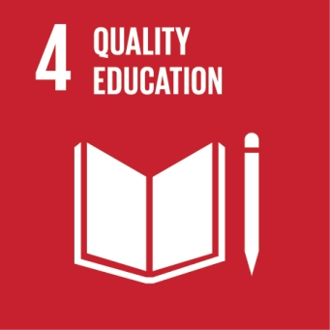


How stakeholder engagement can align educational institutions with the United Nations Sustainable Development Goals (SDGs).
Stakeholder engagement can effectively align educational institutions with the United Nations SDGs in the following ways:
Quality Education (SDG 4): Collaborating with stakeholders such as NGOs and industry experts helps embed SDG principles into the curriculum. This ensures education is inclusive and promotes lifelong learning opportunities.
Gender Equality (SDG 5): Engagement with organizations focusing on gender equality can help institutions address gender disparities in education, particularly in STEM fields.
Industry, Innovation, and Infrastructure (SDG 9): Partnering with industry stakeholders can enhance the focus on innovation and infrastructure in education, driving research and development in sustainable technologies.
13

Slide 14

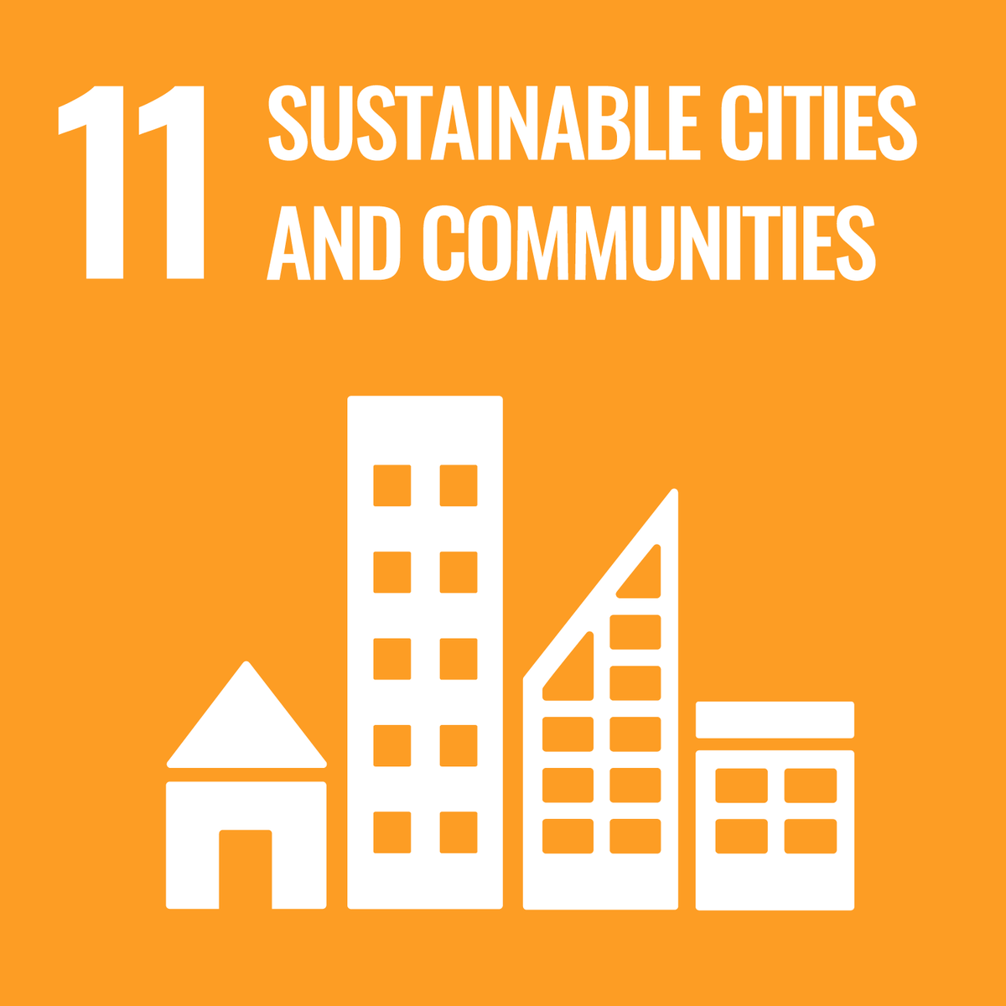

How stakeholder engagement can align educational institutions with the United Nations Sustainable Development Goals (SDGs).
Reduced Inequalities (SDG 10): Collaboration with community groups and non-profits can help address inequalities in access to education and promote inclusive education practices.
Sustainable Cities and Communities (SDG 11): Working with local governments and urban planners can integrate sustainable development practices into education, contributing to the creation of sustainable cities and communities.
Responsible Consumption and Production (SDG 12): Engagement with environmental organizations and businesses can lead to the integration of sustainable consumption and production practices into campus operations.
14

Slide 15
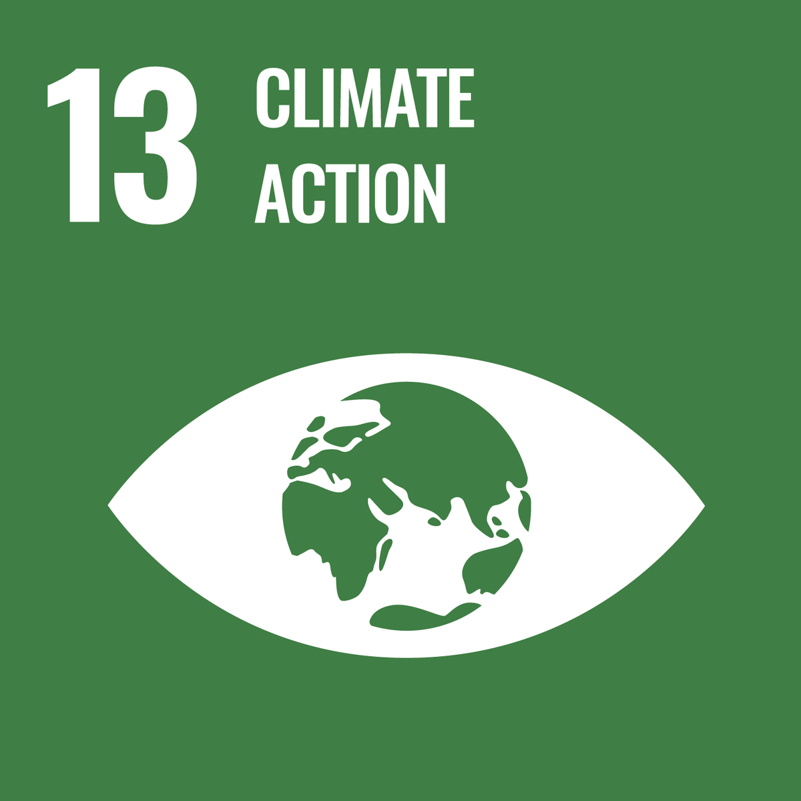
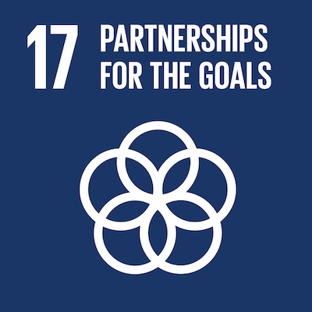
How stakeholder engagement can align educational institutions with the United Nations Sustainable Development Goals (SDGs).
Climate Action (SDG 13): Collaboration with climate action groups can enhance the institution's focus on climate change education and initiatives, aligning with global efforts to combat climate change.
Partnerships for the Goals (SDG 17): By building diverse partnerships, educational institutions can leverage resources, expertise, and networks to advance all SDGs effectively.
15

Slide 16

Case studies of successful stakeholder engagement in European HEIs
Case Study 1: Technische Universität Dresden, Germany (TUD) has a broad spectrum of STEM disciplines and a history of cooperation with various external institutions. They are a partner in The European Platform for Community Engagement in Higher Education www.community-engagement.eu, a web resource to support universities that wish to address societal needs in partnership with their external communities, encompassing public, business and civil society. Funded by the European Union from Erasmus+ programme.
By piloting the TEFCE Toolbox, TUD engaged in participative discussions to categorise and assess their community engagement practices. Despite a lack of central policy for community engagement, many staff and students were actively involved in societal projects, demonstrating a strong commitment to leveraging their knowledge for societal benefits​​.
16

Slide 17
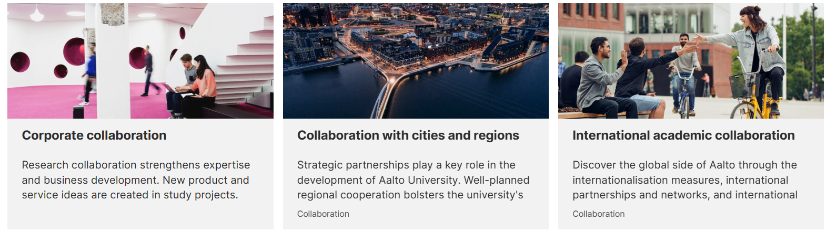
Case studies of successful stakeholder engagement in European HEIs
Case Study 2: Aalto University (Finland) Aalto University - Interdisciplinary Approach and Industry Engagement:
Aalto University is known for its interdisciplinary approach, combining technology, design, and business. The university engages stakeholders by organising collaborative projects and competitions, where students from different disciplines work together to solve challenges posed by industry partners.
17

Slide 18

Case studies of successful stakeholder engagement in European HEIs
Case Study 2: Aalto University (Finland) Aalto University - Interdisciplinary Approach and Industry Engagement:
Aalto's collaboration with companies such as Kone, Nokia, and Fortum provides students with practical experience and helps align their education with current industry needs.
These partnerships not only enhance the educational experience but also foster innovation and prepare students for the demands of the modern workforce.
Curious minds shaping a sustainable future
Our community is working to solve the challenges most consider impossible.
Just some Advancing entrepreneurship and innovations | Aalto University
18

Slide 19

Case studies of successful stakeholder engagement in European HEIs
Case Study 3 Eindhoven University of Technology (tue.nl)
Industry Collaboration Model:
Eindhoven University of Technology is renowned for its close collaboration with high-tech industries in the region, particularly in the Brainport Eindhoven area. The university has established strong partnerships with leading tech companies like Philips, ASML, and NXP Semiconductors. TUE’s stakeholder engagement model contributes significantly to regional economic development and provides students with invaluable industry exposure and experience.
Tu/e and Brainport: a thriving ecosystem
The TUE campus is in the centre of “one of the most powerful technology hubs in the world: Brainport Eindhoven. A collaboration with advanced industries. Together with other institutions, they form a thriving ecosystem with one common aim – to improve quality of life through sustainable innovations.
19

Slide 20
Each of these HEI stakeholder collaboration examples share a common thread – they can be regarded as Entrepreneurial and Engaged Universities that are actively promote entrepreneurship, societal-engagement and innovation among their students and faculty.
As defined by our Be 21 Skilled project partner ACEEU (Accreditation Council for Entrepreneurial and Engaged Universities), engaged and entrepreneurial universities are those that among others, have a clear and captured commitment towards being entrepreneurial/engaged. These universities
embed the spirit of entrepreneurship and engagement into their DNA by making it part of various structures, processes and decisions.
recognize the importance of equipping students with the skills and competencies needed to succeed in a rapidly changing world.
encourage students to develop their entrepreneurial mindset, creativity, and problem-solving abilities, which can lead to the development of new products, services, and businesses.
20

Slide 21

In HEIs, stakeholder engagement means partnering with businesses, local communities, and policymakers to enrich educational outcomes and align with labour market needs.
By engaging with external stakeholders, higher education institutions can increase their institutional effectiveness, foster culture of continuous improvement, enhance reputation, and contribute to a better 21st century skills development through
A shift from industrial to knowledge-based economies.
Meeting the growing importance of globalisation and technology in the educational context.
Tackling the urgent need for graduates to have adaptable and diverse skill sets.

Slide 22
Barriers to Engagement
Common barriers to effective stakeholder engagement include institutional resistance to change, limited resources, and lack of clear communication channels.
HEIs can overcome these obstacles by fostering a culture of adaptability, securing dedicated resources for engagement activities, and establishing transparent communication practices.
Overcoming these barriers is critical for HEIs to remain responsive to stakeholder needs and maintain relevance.
22

Slide 23
Regional Adaptability
We have seen that Regional Skills Councils (RSCs) facilitate collaboration between HEIs and local industries and other stakeholder, bridging the gap between academic learning and practical applications. This collaboration can result in a curriculum that is responsive to the specific skill needs of the regional workforce.
Such external collaboration clearly supports regional development strategies. By aligning educational offerings with local growth areas, RSCs
contribute to the economic development of the region, creating job opportunities and attracting investments.
play a critical role in responding to changes in regional labour markets, such as shifts due to technological advancements or emerging industries.
help HEIs quickly adapt curricula to prepare students for these new opportunities."
03
23

Slide 24
Involvement in RSCs offers HEIs the chance to partake in a larger dialogue about regional development, ensuring that their programs not only produce skilled graduates but also contribute to the broader societal goals and regional sustainability.
RSCs in ensuring that HEIs are adaptable to the specific needs and opportunities of their regions, thereby making education more relevant and impactful.
Let us see how Regional Skills Councils operate in Latvia and Serbia and then on a pan EU level. .

Slide 25
The Latvian Approach
Latvia has established a robust system of 13 Sectoral Expert Councils that work with HEIs to develop qualifications frameworks and occupational standards. These councils ensure that the educational offerings of HEIs are aligned with industry needs and foster partnerships that are integral throughout the educational process, from curriculum planning to assessment of learning outcomes.
1. Business, Finance, Accounting and Administration
2. Chemical and Environmental SEC
3. Construction SEC
4. Cultural Education Council
5. Energy SEC
6. Food Production and Agriculture SEC
7. Manufacturing of electronic and optical equipment, ICT SEC
8. Metalworking, machine building, mechanical engineering SEC
9. Print and Media Technology SEC
10. Textiles, Clothing, Leather and Leather Goods Manufacturing SEC
11. Timber industry SEC
12. Tourism and Beauty SEC
13. Transport and Logistics SEC
25

Slide 26
Sectors where no SECs have been established cover mostly those areas that are financed by the state and regulated by separate regulatory acts e.g. Defence, Customs Policy, etc..
In terms of their formatting, Sectoral Expert Councils in Latvia are tripartite and include:
State representatives (ministries and public agencies),
Employers’ representatives (employer organisations, professional associations),
Employees’ representatives (trade unions and their associations).
Interestingly, the number of employers’ and professional organisations’ representatives should form at least half of all Sectoral Expert Councils members.
Decisions are made by majority vote, but in practice usually by consensus.
It is notable that VET institutions cannot be voting members of SECs, but relevant VET institutions (especially those responsible for methodological development) are invited to participate as permanent observers.
26

Slide 27
Management and Operations
As we see, SECs in Latvia are independent in their decision-making. Each SEC has its chairperson and vice-chairperson (can be multiple), elected from among the members of SECs.
Inter-sectorial management and co-operation is implemented though non-formal consultative meetings with SEC Council involving leadership representatives and co-ordinators of all SECs.
In terms of operations 11 SECs are coordinated by the LDDK, the national coordinator of SECs, 1 SEC by LOSP, and 1 SEC by LNKC
The LDDK and LOSP as co-ordinating institutions of SECs are accountable to the Ministry of Education and Science for implementing the tasks in the annual funding agreement.
27

Slide 28
Financing
LDDK and LOSP are funded by public funding (1-year long agreement between the MoES and the coordinating institution).
Members of SECs work voluntarily.
FIND OUT MORE
Procedures for Establishment, Operation, and Coordination of Activities of Sectoral Expert Councils, available in English though this link.
Sectoral qualification frameworks , available in Latvian through this link.
We can recommend an interesting publication by our Be 21 Skilled collaborator, Anita LĪCE, entitled A short guide to Sectoral Expert Councils in Latvia, Lithuania and Estonia, a brief overview on the functioning of Sectoral Expert Councils - shaping VET according to the needs of the labor market - in the three Baltic states. Accessible via this link …
A short guide to Sectoral Expert Councils in Latvia, Lithuania and Estonia | EPALE (europa.eu)
28

Slide 29
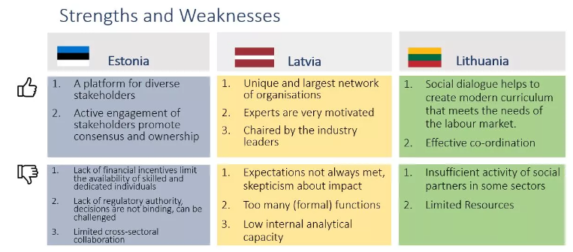
The publication is part of the Erasmus+ programme KA210 -VET - Small-scale partnerships in vocational education and training No – 2021-2-LV01-KA210-VET-000051300 “Strengthening cooperation between the institutions coordinating the work of sectoral expert councils in the Baltic states” (SECBaltics). Every system has both successful aspects and things to improve. Here are the main strengths and weaknesses as seen by the Council coordinators in the three Baltic states.
29

Slide 30
The Serbian Approach
Serbia's main mechanisms for integrating 21st-century skills into higher education include the Council of Employers, the dual model of studies, and Sectoral Skills Councils.
Serbia has introduced the concept of the Council of Employers within HEIs to guide the development of study programmes based on labour market needs. As highlighted in our Project Result 1 (the Conceptual Basis of 21CS, the Regional Relevance and status quo and Skill Panorama), the Serbian dual model of studies combines academic learning with practical training, offering students real-world experience and better preparing them for employment. In addition, Sectoral Skills Councils play a key role in aligning education with industry by identifying qualifications and promoting dialogue between work and education spheres.
CoR - Serbia Employment (europa.eu)
30

Slide 31
These bodies provide recommendations for modernising curricula, aligning educational outcomes with market trends, and support students through extracurricular activities. The dual model allows the implementation of curricula through both academic instruction and practical training at employers' sites.
The objectives of the Local Employment Councils (LECs) include:
Improve the community development and provide funding;
Analyse local labour markets;
Develop measures to increase employment through Local Employment Action Plans;
Contribute to the implementation of the National Employment Strategy;
Stimulate entrepreneurship and create conditions for new jobs;
Human resource development (matching skills provision with the needs of employers);
Tackle unemployment, especially for disadvantaged groups.
31

Slide 32
Serbian Dual Model's Impact on STEM Education,
The dual model's blend of academic theory and practical application addresses the unique demands of STEM careers, such as the need for hands-on experience with cutting-edge technologies. This educational approach equips students with a balanced skill set, fostering both technical expertise and practical problem-solving abilities.
STEM education benefits greatly from the dual model as it prepares students to be innovators and agile thinkers in sectors where the pace of change is rapid.
According to Template Studies Content (prosveta.gov.rs) , the development of education that will meet the needs of the labour market to the maximum extent and the development of the national model of dual and entrepreneurial education were priority goals of the Government of the Republic of Serbia for the last few years, and in accordance to such directions the Law on Dual Education is developed and adopted. In more concrete terms, the Law on Dual Education (LDE) was adopted in November 2017 (Official Gazette of the Republic of Serbia, 101/17).
32

Slide 33
Serbian Dual Model's Impact on STEM Education,
According to this law, dual education is a model of realization of teaching and learning in the system of secondary vocational education, in which through theoretical and school teaching and learning through work with the employer, students acquire competencies in accordance with the standard of qualification and the curriculum of teaching and learning. The Law on Dual Education itself defines goals of dual education (Article 4).
improvement of secondary vocational education that will be adapted to the needs of the economy;
increasing the scope and quality of practical teaching;
ensuring the quality of the practical part of teaching through the contractual designation of rights and obligations of pupils, schools, and employers;
developing curricula that are in line with the current and future needs of the economy;

Slide 34
Serbian Dual Model's Impact on STEM Education,
a systematic, rational and gradual approach to the introduction and development of dual education with a comprehensive understanding of the process, from beginning to end of education;
creation of a system in which the qualification acquired at the end of dual education is indeed an expression of the acquired competencies, thus increasing the employability of the youth;
companies investing in education, i.e. in its future workers, that will, in the long run, solve the problem of the lack of certain quality personnel;
reduction of expenses allocated by the Ministry for vocational education, primarily for equipping school classrooms, workshops for the realization of a practical part of teaching;
increasing the chances that students will get employed in one of the companies where work-based learning was taking place,
the development of entrepreneurship among young people and the incentive to start their own business, as well as continuing education in vocational studies and faculties.
34

Slide 35
Latvia and Serbia: A Comparative Analysis
Both Latvia and Serbia have implemented mechanisms to involve stakeholders in HEIs. Latvia utilises Sectoral Expert Councils while Serbia has established the Council of Employers and adopted a dual education model."
In Latvia, engagement is continuous and spans from curriculum planning to thesis defence. Serbia focuses on integrating practical work experiences with academic learning.
Despite differences in execution, both countries share the objective of aligning education with evolving labour market needs, preparing students with relevant 21st-century skills.
35

Slide 36

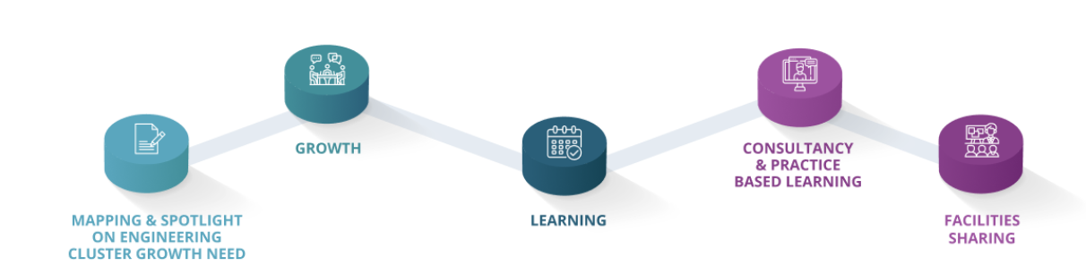
SPOTLIGHT ON CLUSTERS FOR STAKEHOLDER ENGAGEMENT
SME Cluster Growth is an ERASMUS+ Knowledge Alliance project to empower SMEs in the engineering sector to grow and compete. The project team is led by the University of Málaga, Spain and spans nine partners across seven European countries. It is an ambitious collaboration with higher education institutions (HEIs), future skills and business growth professionals and university-industry relationship experts to advance engineering SMEs’ capacities. They do this through five support areas, including: Mapping, Cluster Growth Councils, Learning, Consultancy and Facilities Sharing, each of which is relevant to Stakeholder Engagement for Be 21 Skilled.
36

Slide 37
SPOTLIGHT ON CLUSTERS FOR STAKEHOLDER ENGAGEMENT
Following a successful SME survey spanning 500 engineering businesses across Europe, SME Cluster Growth partners established six Cluster Growth Councils. Each serves as a platform to develop closer relationships between Engineering SMEs and universities in order to build joint action plans and strategies and align activities with local and regional issues and innovation agendas to solve their common challenges collaboratively.
Six Engineering Cluster Growth Councils, based in consortium cities and surrounding regions (Malaga, Alcalá de Henares, Bologna, Cork, Istanbul, and Paris), each have a collaboration network and culture for joint innovation in their partner regions.
Check them out via these links
Alcalá de Henares Bologna Cork
Istanbul Malaga Paris
37

Slide 38
SPOTLIGHT ON CLUSTERS FOR STAKEHOLDER ENGAGEMENT
ISTANBUL - The Turkish SME Cluster Growth Council
Developed by BOĞAZİÇİ TEKNOPARK anasayfa (boun.edu.tr) with the ambition to bring together stakeholders having an impact on the growth endeavors of SMEs in the information and communication technology ecosystem. The Council includes representatives from technoparks, the ICT industry, consultants, entrepreneurs and HEIs and acts as a board, especially for the validation of the Istanbul Technical University activities for the SME Cluster Growth Project. Quote from a HEI member of the Council..
“Being a member of the Council enabled me to perceive the difficulties of SMEs more closely and to discuss alternative solutions to guide them on their growth path. Recruiting and retaining qualified personnel at a micro level and facilitating access to financial support are the most crucial problems to address in order for SMEs to grow healthily”.
38

Slide 39
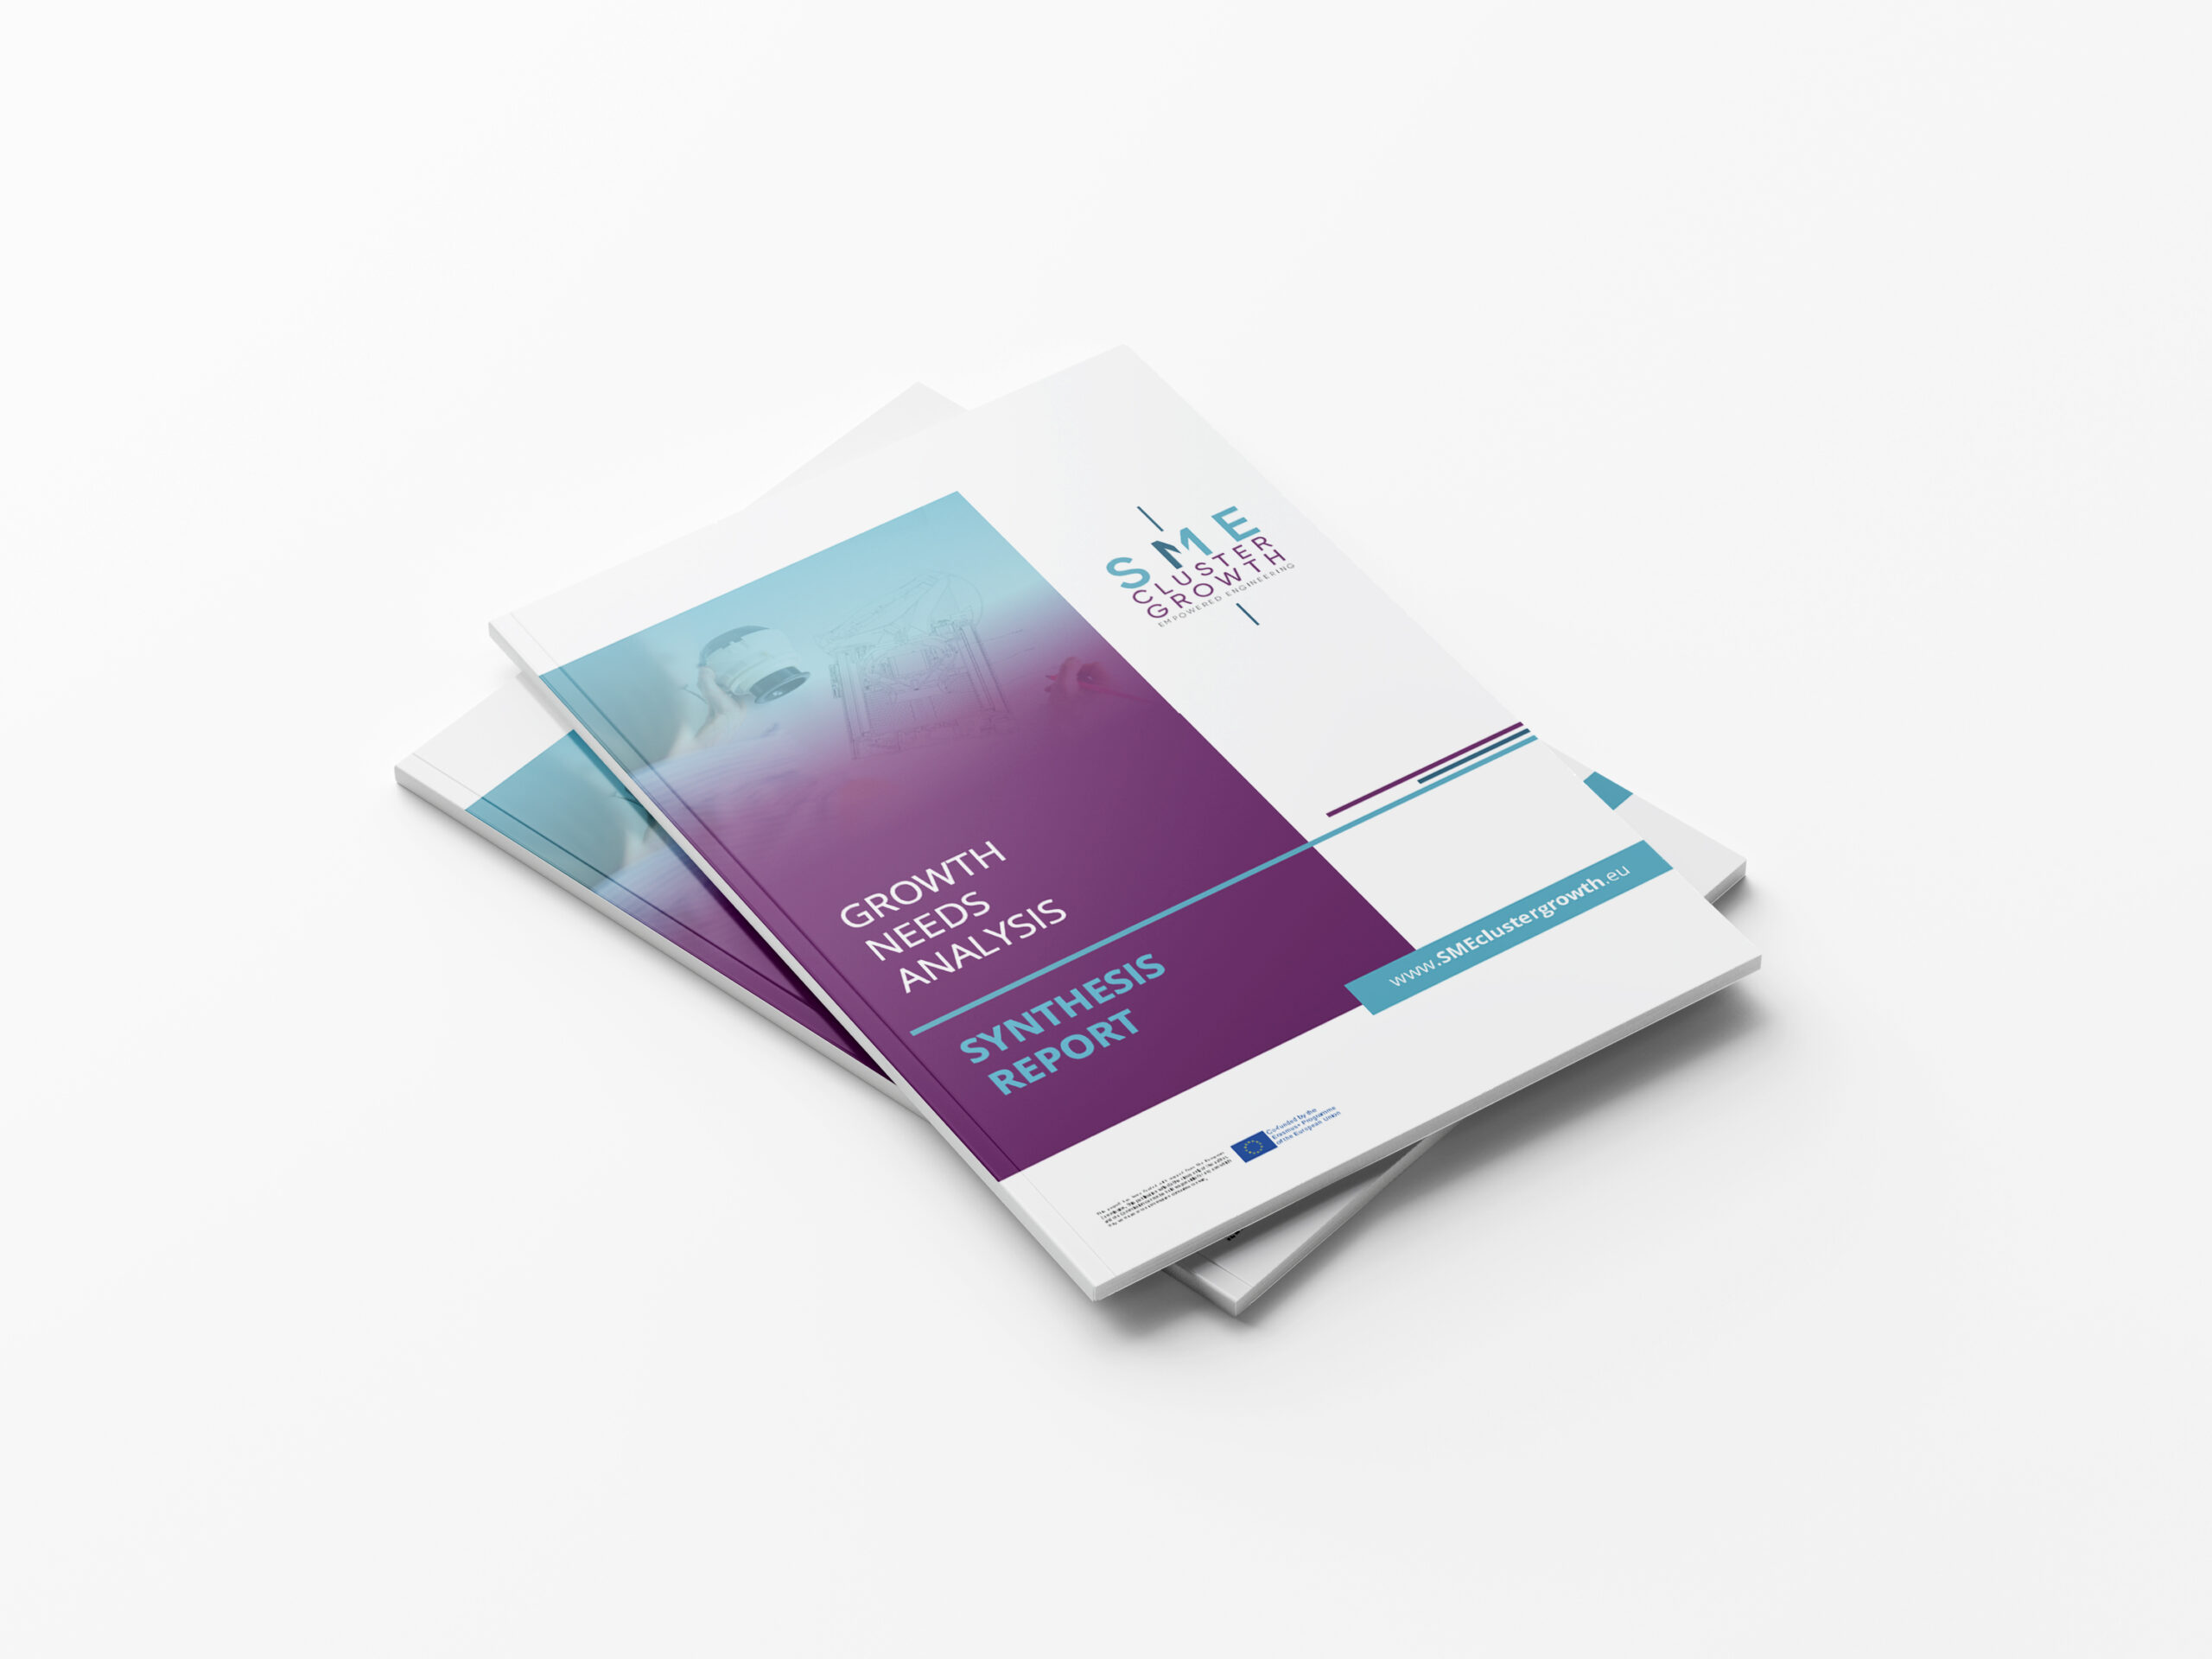
SPOTLIGHT ON CLUSTERS FOR STAKEHOLDER ENGAGEMENT
During the SME Cluster Growth project development phase it investigated the issues facing growth SMEs through a comprehensive set of expert and owner interviews, case studies and a major growth needs analysis survey.
This Growth Needs Analysis Synthesis Report distils and presents the main findings from this survey, research and interviews with groups of experts, SME representatives, entrepreneurs, and other relevant stakeholder groups and is interesting additional reading for our Be 21 Skilled teachers.
Resources - SME Cluster Growth
39

Slide 40
Skills Identification and Integration
We have seen that Regional Skills Councils (RSCs) identify skills gaps, particularly in STEM fields, which isa pressing concern for employers across Europe. By collaborating with HEIs, employers aim to ensure that education keeps pace with technological advancements and industry needs. Thus, targeted educational strategies, informed by employer input, are essential in producing a workforce that is competent and competitive.
In terms of Skills Identification, Skills Councils play a pivotal role in identifying key skills required in the current and future workforce. They conduct comprehensive labour market analyses to discern emerging trends and skill gaps. By collaborating with industry leaders, they gather insights on required technical and soft skills, ensuring that the workforce meets the evolving demands of various sectors. "This identification process is critical for informing educational institutions about the specific skills that need to be integrated into their curricula, ensuring that students are well-prepared for their professional journeys.
04
40

Slide 41
Integrating Skills into Curriculum
Once key skills are identified, Skills Councils can work closely with HEIs to integrate these skills into educational programs. This involves updating existing courses and developing new ones that align with industry needs. In the main, we see that Councils advocate for a balance between theoretical knowledge and practical skills, ensuring that graduates possess a well-rounded skill set. They also encourage the inclusion of interdisciplinary and experiential learning opportunities, such as internships and project-based learning, to provide students with real-world experience.
Bridging the Skills Gap
Throughout our Modules, the issue of skills gaps arise time and time again. Skills Councils are instrumental in bridging the gap between the skills taught in educational institutions and those demanded in the labour market. By ensuring that educational programs are closely aligned with industry needs, Skills Councils help reduce the skills mismatch and improve graduate employability.
Continuous Skills Monitoring and Updating
When working effectively, Skills Councils are engaged in continuous monitoring of the labour market to anticipate future skills needs. This proactive approach helps educational institutions stay ahead of the curve, providing regular updates and recommendations to HEIs for curriculum enhancement, ensuring that education remains dynamic and responsive. This ongoing process ensures that educational programs evolve in tandem with industry advancements, preparing students to meet the challenges of an ever-changing job market.
41

Slide 42
A good example of a Regional Skills Council impacting curriculum development is the Regional Skills Fora in Ireland. This network was created as part of the Irish Government’s National Skills Strategy and provides an opportunity for employers and the education and training system to work together to meet the emerging skills needs of their regions. The Fora contributes to better outcomes for learners and supports enterprise development through several ways¹:
Providing a single contact point in each region to help employers connect with the range of services and supports available across the education and training system.
Offering more robust labour market information and analysis of employer needs to inform programme development.
Encouraging greater collaboration and utilization of resources across the education and training system and enhancement of progression routes for learners.
Creating a structure for employers to become more involved in promoting employment roles and opportunities for career progression in their sectors.
This structured engagement on the skills agenda and the work of the Fora contributes to curriculum development by ensuring that the education and training system is responsive to the needs of the economy and the workforce². This is a clear example of how a Regional Skills Council can have a significant impact on curriculum development.
42

Slide 43
Evolving Curriculum Development
  Throughout this Module, we have seen that Regional Skills Councils are key players in aligning education with regional workforce needs. They provide strategic insights to HEIs on evolving industry trends and skills requirements. But that involvement needs to be ongoing and constant in maintaining a cycle of continuous improvement in higher education.
  RSCs need to ensure that curricula reflect the latest technological advancements and industry practices, making education more relevant and applicable to real-world scenarios. Their role extends beyond mere consultation; they actively participate in shaping and updating academic programs to meet the dynamic needs of the regional economy.
05
43

Slide 44

  The Midlands Regional Skills Forum in Ireland is a great example of a Skills Fora or Regional Skills Council working in STEM. They have been actively involved in promoting STEM education and careers in their region. One of their initiatives was the Midlands Science Festival, an annual event that aims to promote science, technology, engineering, and mathematics (STEM) subjects.
  The Midlands Regional Skills Forum also works closely with local businesses, education and training providers to ensure that the skills needs of the STEM sector are being met. They help in identifying the current and future skills needs of the region and ensure that there is a sufficient supply of STEM skills to meet the demand.
44

Slide 45
Our next Module turns the focus to our students and innovative pedagogical practices.
BE 21 SKILLED TEACHER EMPOWERMENT PROGRAM
MODULE 4
Innovative pedagogical practices to boost the relevant 21CS in students
www.be21skilled.eu

Slide 46
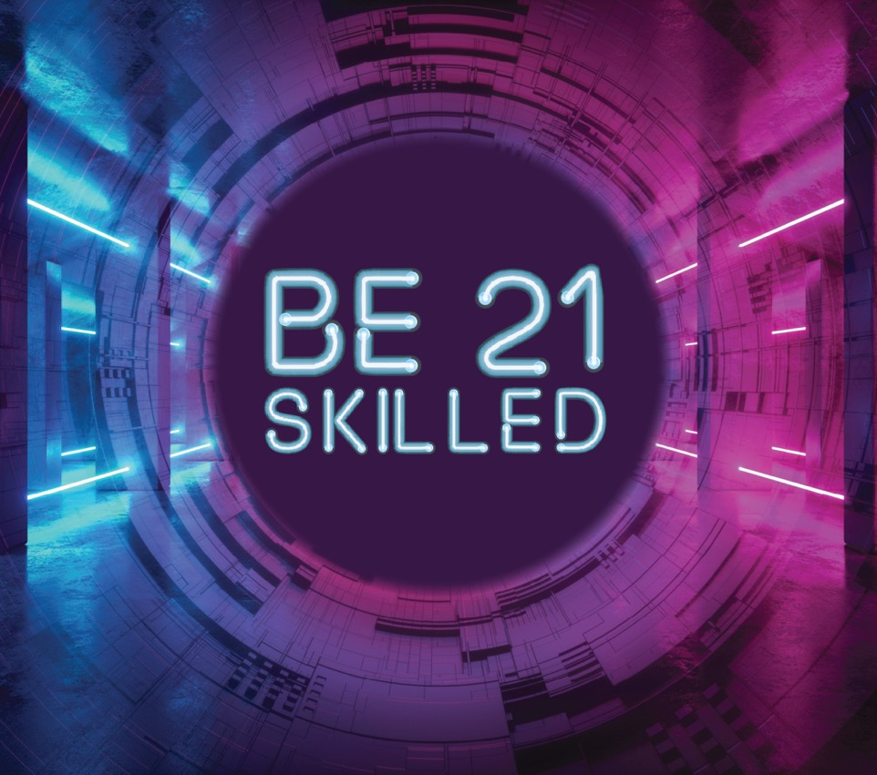


Follow our journey here
www.be21skilled.eu
46

