Slide 1
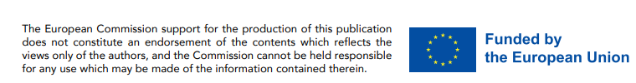
BE 21 SKILLED TEACHER EMPOWERMENT PROGRAM
MODULE 1
21ST CENTURY SKILLS
www.be21skilled.eu
IN A NUTSHELL

Slide 2

01
BE21SKILLED project overview
TABLES OF CONTENTS
02
The Process of Defining 21st Century Skills
03
Self-management, Purposefulness, Perseverance
04
Communication, collaboration and teamwork
05
Growth mindset and learning
06
Responsibility and fairness
07
Adaptability, resilience and stress resistance
08
Creativity, curiosity, open mindset, spotting opportunities
09
Information and data literacy, information interpretation
10
Wellbeing, positive attitude and mindfulness
11
Emotional intelligence and empathy
This work is licensed under a Creative Commons Attribution-Non-Commercial-No Derivatives 4.0 International License (CC BY-NC-4.0) International License.
Project number: 2021-1-LV01-KA220-HED-000027581
12
Critical thinking, problem-solving and systems thinking
13
Leadership

Slide 3
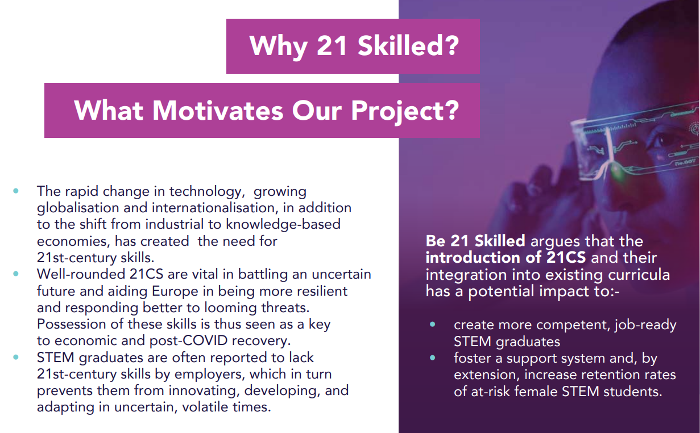
01
BE21SKILLED project overview

Slide 4
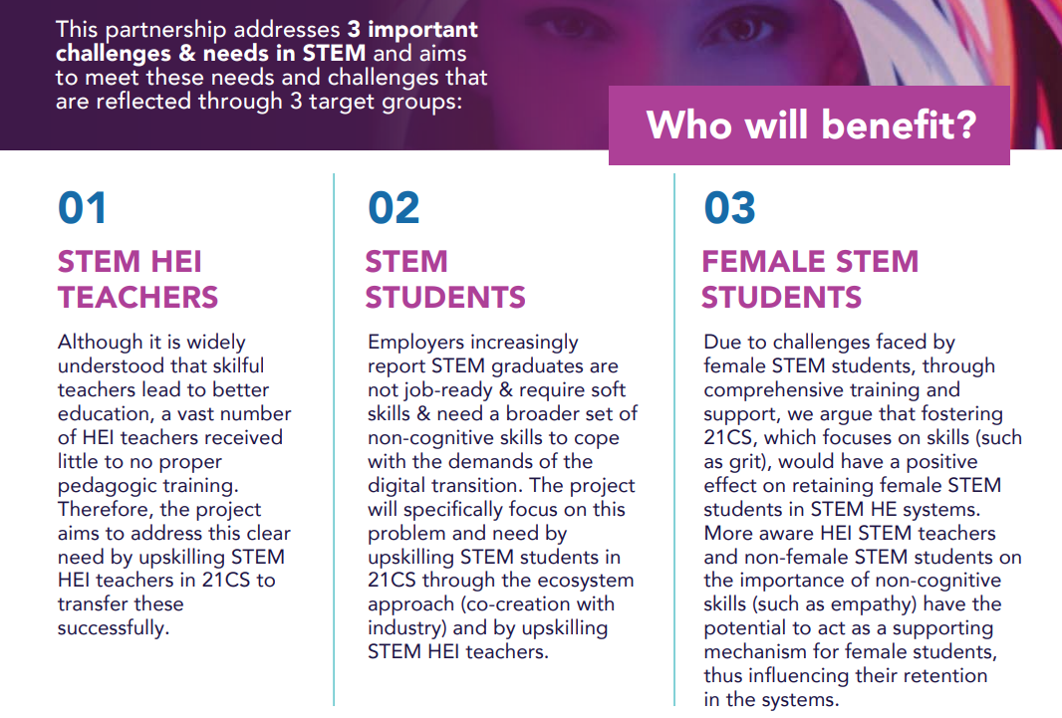

Slide 5

The Be21Skilled project is clear that the introduction of 21st century skills and their integration into existing curricula has the potential impacts of
Creating more competent, job-ready STEM graduates
Fostering a support system and by extension increasing retention rates of at-risk female STEM students,

Slide 6
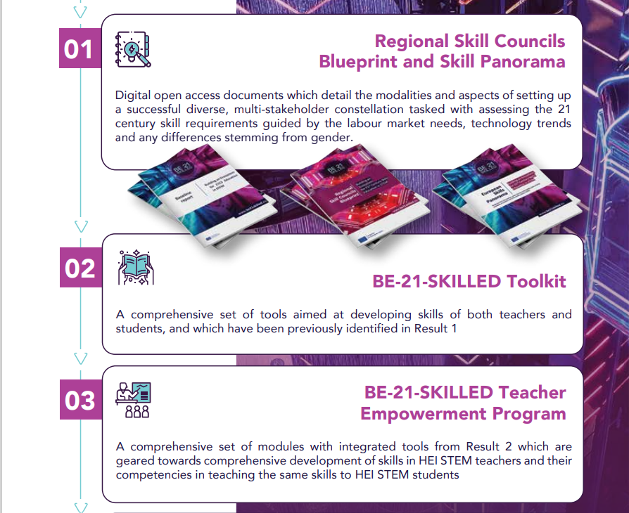

5 KEY DELIVERABLES/RESULTS

Slide 7

The 5 KEY objectives of the Be21Skilled project are to:
Facilitate the understanding and identification of 21st century skills in region-specific and labour-market relevant contexts through multi-stakeholder collaborative efforts.
Foster the HEI teachers' abilities to instil 21st century skills in their students via training and feedback loops.
Enhance the skills among students to increase their employability and capitalise on their innovative potential.
Improve the understanding of non-female STEM actors (students, teachers, employers, etc.) on the need to support female STEM students and instil 21st century skills in them.
Innovate the curricula by embedding tools targeted at developing particular skills in students.
7

Slide 8
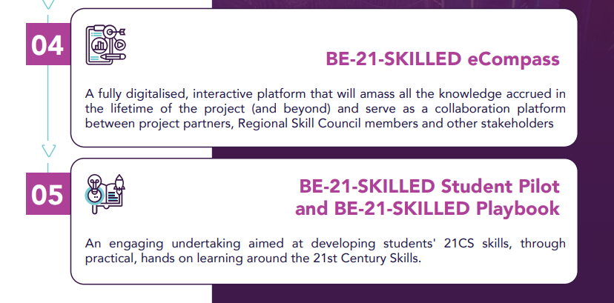
5 KEY DELIVERABLES/RESULTS

Slide 9
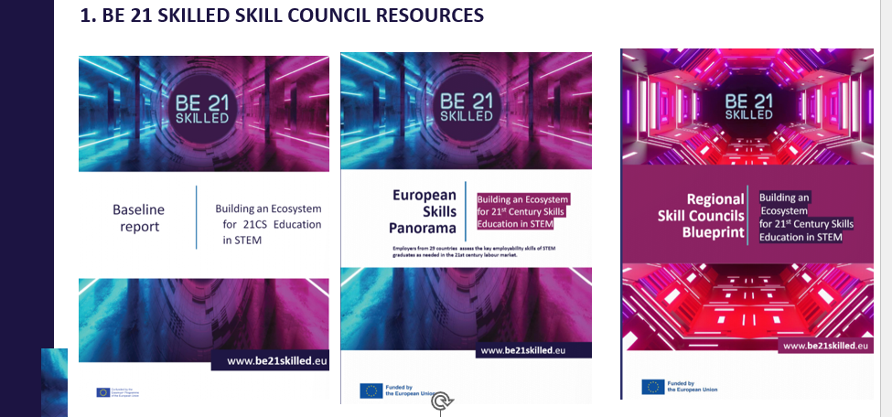
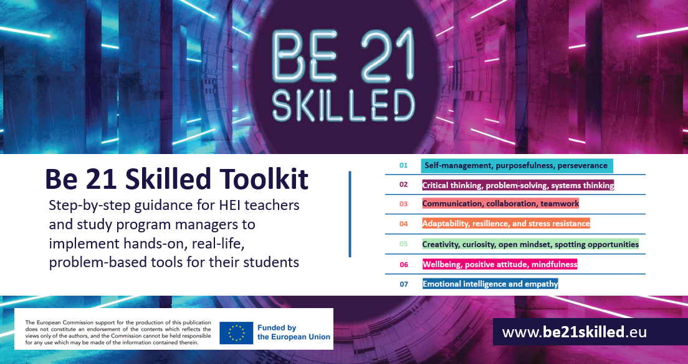
BE 21 SKILLED TEACHER EMPOWERMENT PROGRAM
BUILDING ON A SOLID FOUNDATION
The BE-21-SKILLED Teacher Empowerment Program targets HEI STEM teachers in particular with the aim of simultaneously upskilling the teachers on 21CS and training them in transferring those skills onto their students. The resulting modules can be chosen by the teachers according to their interests on specific skills to develop within the project. This flexible content selection ensures 1) scalability of the project to different regions, and 2) adaptability to specific regional contexts and their needs.
The Empowerment Program builds on
the conceptual basis of 21CS
the regional relevance and status quo
Skill Panorama
4) the incorporation and use of a dynamic Toolkit for student upskilling.
9

Slide 10

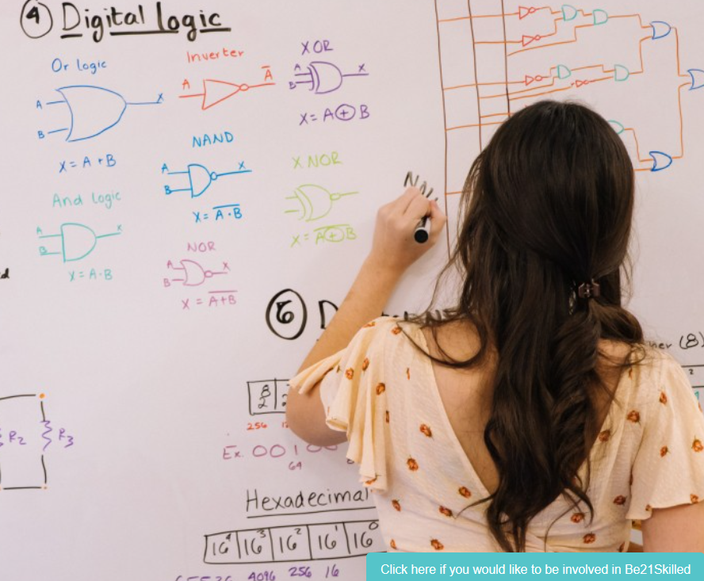
The Process of Defining 21st Century Skills
02
10

Slide 11
BUILDING ON A SOLID FOUNDATION
Defining 21st century skills was a task our EU consortium took very seriously. Beyond academic research and policy, there was little to interpret how such skills could be brought to classroom level.
As we will see later in Module 3, Regional Skill Councils were set up in each partner region to provide the scaffolding for the entire project. Each Council (Latvia and Serbia) were comprised of relevant stakeholders from their respective region (HEI teachers, business and NGO representatives, government representatives and students and in particular female leaders).
Together with project partners, these Councils have been instrumental in guiding the definition of 21st century skills.
Let’s summarise that process.
11

Slide 12
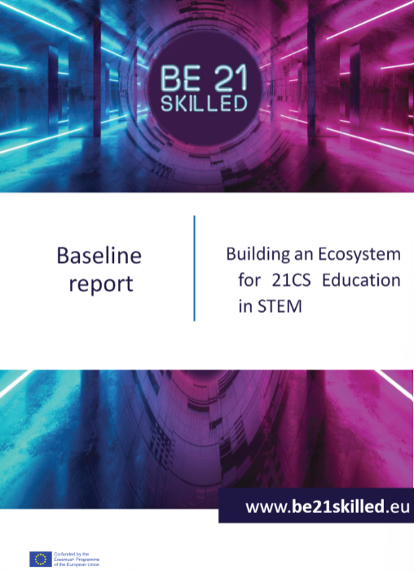
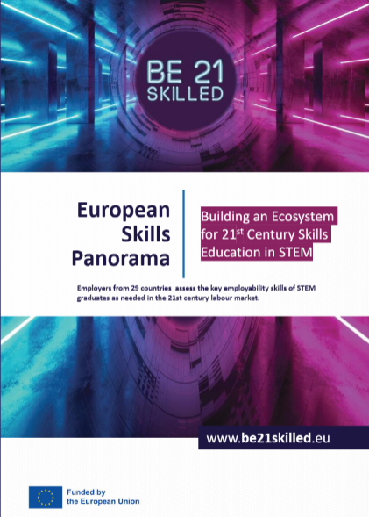
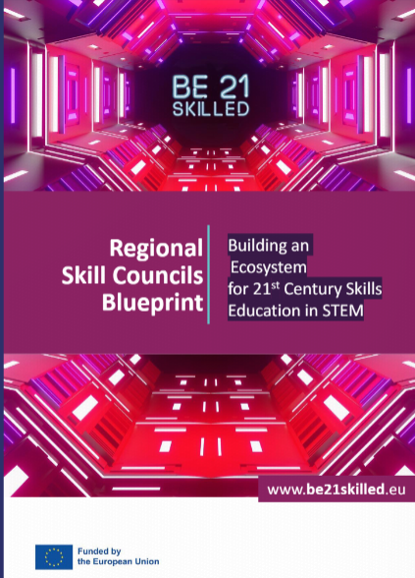
1. BE 21 SKILLED SKILL COUNCIL RESOURCES
AVAILABLE ON https://be21skilled.eu/resources/
12

Slide 13
SPOTLIGT ON KEY GUIDING RESEARCH
Baseline Report: sets the baseline for the first activities of the BE-21-SKILLED project and the consultations with external partners involved in the Regional Skill Councils.
EXISTING 21ST CENTURY SKILLS FRAMEWORKS - it summarises the status quo on the 21 century skills, based on scoping and desk research results and meta-analysis of international 21 CS frameworks, including
OECD Learning Framework 2030
Joint Cedefop-Eurofound Publication on Skills Forecast to 2030
EU EntreComp, GreenComp, DigComp and LifeComp
The Future of Jobs 2020 Report by the World Economic Forum (2020)
And others. All skill frameworks analysed were current, research-based, internationally recognized.
13

Slide 14
A FLAVOUR OF THE OECD LEARNING FRAMEWORK 2030
Identifies three cross-cutting transformative competencies for 2030 that address the growing need for young people to be innovative, responsible and aware (Taguma et.al, 2016, p.10-13; OECD, 2018, p.5-7):
1. Creating new value – innovating to shape better lives, such as creating new jobs, businesses and services, as well as developing new knowledge, insights, ideas, techniques, strategies and solutions and applying them to problems both old and new. Questioning the status quo, collaborating with others and trying to think “outside the box”.
2. Reconciling tensions and dilemmas – taking into account the many interconnections and inter-relations between seemingly contradictory or incompatible ideas, logics and positions, as well as considering the results of actions from both short- and long-term perspectives. Acquiring a deeper understanding of opposing positions, developing arguments to support own position and finding practical solutions to dilemmas and conflicts.
14

Slide 15
A FLAVOUR OF THE OECD LEARNING FRAMEWORK 2030
3. Taking responsibility – the ability to reflect upon and evaluate one’s own actions in light of one’s experience and education, and by considering personal, ethical and societal goals.
The OECD Education 2030 Framework translates these transformative competencies and other key concepts into 36 specific 21CS skills (OECD, 2018, p.18) so that teachers and school leaders can better incorporate them into curricula.
https://www.oecd.org/education/2030/learning-framework-2030.htm/
15

Slide 16
JOINT CEDEFOP-EUROFOUND PUBLICATION ON SKILLS FORECAST TO 2030
A synopsis of the results of the Cedefop’s skill supply and demand projections, based on the current structure of Europe’s labour market and potential future trends, along with Eurofound’s analysis on the task content of employment, using the jobs monitor approach.
EU EntreComp
The common reference framework that identifies 15 competences in three key areas that describe what it means to be entrepreneurial. EntreComp offers a comprehensive description of the knowledge, skills and attitudes that people need to be entrepreneurial and create financial, cultural or social value for others. The entrepreneurship competence is increasingly recognised as a competence for life, relevant to personal development and fulfilment, finding and progressing in employment.
16

Slide 17
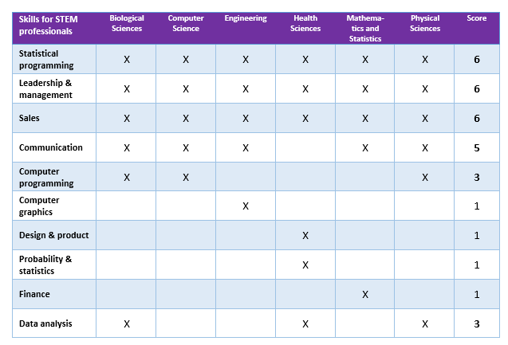

THE COURSERA “UNBOUNDED UNIVERSITY” REPORT
The Coursera “Unbounded University” report (2021) is the only report among the selected that was STEM-specific and offered skillset for each STEM field.
The report leverages data from millions of learners on Coursera to identify skills proficiency gaps between students and working professionals that may contribute to the employability gap.
The BE21SKILLED project team selected TOP 6 skills of working professionals relevant across several STEM fields
17

Slide 18
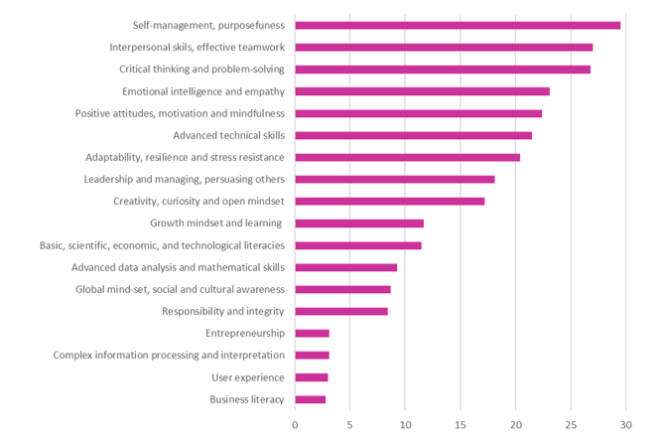
Clear findings emerged
18

Slide 19
It should be noted that the list of 21 CS has been developed to include general competencies and competencies that apply equally to all areas of STEM education. It does not cover professional skills or skills that are specific only to certain fields or occupations.
And we then mapped the competencies against our Employer’s Perspectives (the focus of Module 2)….

Slide 20
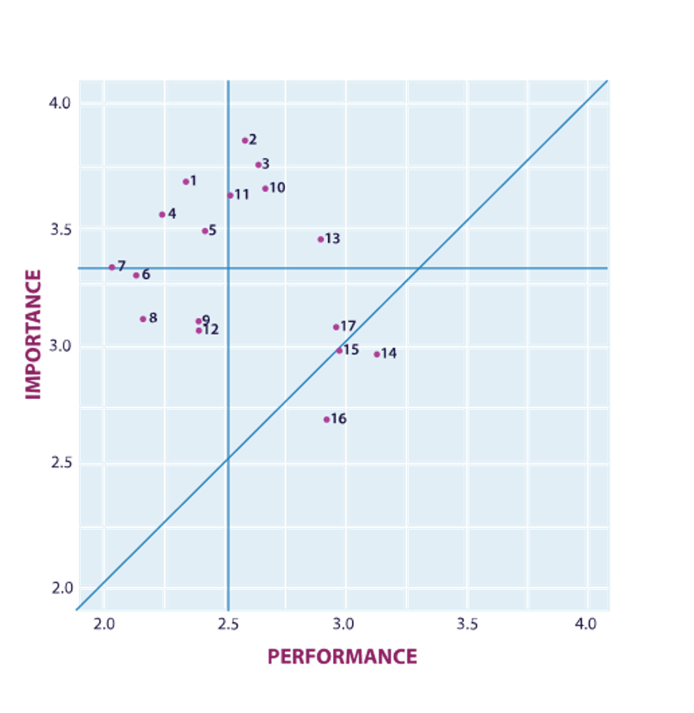

Self Management, purposefulness, perseverance
Critical thinking, problem-solving and systems thinking
Communication, collaboration, teamwork
Adaptability, resilience and stress resistance
Creativity, curiosity, open mindset, spotting opportunities
Wellbeing, positive attitudes, mindfulness
Emotional intelligence and empathy
Vision, leadership, mobilising and managing others
Sustainability competence
Growth mindset and learning
Responsibility and fairness
Global mind-set, social and cultural awareness
Information and data literacy, information interpretation
Basic, scientific, economic, and technological literacies, basic physics and chemistry
Advanced data analysis and mathematical skills
Computer Programming
Advanced technical skills
Importance – performance analysis results of importance of 21st century skills and performance of universities in developing them Source: Authors’ calculations based on employer survey conducted in 2022, n=300

Slide 21
The most critical area requiring action is where importance of skills is high, but performance of universities is low. Underperformance in these areas requires immediate attention and highest prioritization:
1
‘Self-management, purposefulness, perseverance’
11
‘Responsibility and fairness’
4
‘Adaptability, resilience and stress resistance’
7
‘Emotional intelligence and empathy’
5
‘Creativity, curiosity, open mindset, spotting opportunities’
6
‘Wellbeing, positive attitudes and mindfulness’
And thus, our competence areas were emerging. Let’s review them…
21

Slide 22
Self-management, Purposefulness, Perseverance
The skills mentioned in the international skills framework, which the Be 21 Skilled partners consider to be related to each other and which are combined in this group of skills, are:
Autonomy
Self-efficacy
Self-awareness and self-management
Self-control, self-regulation, self-direction
Goals achievement
Goal orientation and completion (e.g., grit, persistence)
Decision making
Motivation & perseverance
Planning & management
Project management
Risk management
Resource management
03
22

Slide 23
According to the ESCO (European Commission, n.d.), self-management skills and competences require individuals to understand and control their own capabilities and limitations and use this self-awareness to manage activities in a variety of contexts.
They include the ability to act reflectively and responsibly, to accept feedback, adapting to change and to seek opportunities for personal and professional development. Self-management skills and competencies can alternatively be called as:
self-control
self-regulation
self-management
self-discipline and
professional attitude

Slide 24

According to research purposefulness is a volitional quality, that characterized by the goals and objectives, orderliness and balance of actions, thoughts, and feelings with a steady movement towards the goal. It is the quality of having a sense of direction and a strong motivation to achieve a specific outcome.
Perseverance is the human abilities to storage energy by long-term, to achieve the goal, to overcome the difficulties of varying magnitude (Griban et al., 2020). Together, purposefulness and perseverance are important qualities that can help an individual achieve their goals and overcome challenges.

Slide 25
Critical Thinking, Problem-solving & Systems Thinking
Related skills:
Analytical thinking
Cognitive processes and strategies
Critical thinking and decision making
Problem framing
Problem-solving, complex problem-solving
Reasoning, problem-solving and ideation
System skills
Systems analysis and evaluation
04
25

Slide 26
Thinking skills and competences can alternatively be called as:
Cognitive skills and competences
Use of reason and logic
According to the ESCO (European Commission, n.d.), thinking skills and competences are related to the ability to apply the mental processes of gathering, conceptualizing, analysing, synthesizing, and/or evaluating information gathered from, or generated by, observation, experience, reflection, reasoning, or communication.
They include the ability to evaluate and use information of different kinds to plan activities, achieve goals, solve problems, deal with issues and perform complex tasks in routine and novel ways.

Slide 27
Critical thinking is a higher-order thinking skill that is crucial to cope with uncertainty, complexity, and change. It entails a self-directed, skillful analysis of information, beliefs or knowledge, with an ongoing reconstruction of one’s thinking knowledge about methods to assess and produce new knowledge and strategies to solve problems. It assumes awareness of the egocentric and sociocentric tendencies of human thinking that may produce flaws in the quality of reasoning, as well as willingness to critically assess and evaluate information (Sala, Punie, Garkov and Cabrera, 2020).
Problem-solving is the process of finding solutions to difficult or complex issues’ (Simpson, Weiner, & Oxford University Press, 1989). Problem-solving normally requires the use of a range of tools and information resources. The core characteristic of problem-solving is that it is impossible for a person to achieve the goal through routine actions. In problem-solving, one has to reflect on the situation in order to identify the proper arrangement of decisions and actions that may lead to a solution. It often involves interaction with other individuals, and thus communicating in spoken or written form may be one of the actions necessary to solve the problem. Tools and technologies can normally facilitate the resolution of the problems (OECD, 2012).
27

Slide 28

Critical thinking and problem-solving skills are closely related to other employability competencies. According to Council of the EU (2018), a problem-solving attitude supports the learning process and the individual's ability to handle obstacles and change.
It includes the desire to apply prior learning and life experiences and the curiosity to look for opportunities to learn and develop in a variety of life contexts
28

Slide 29
Communication, Collaboration and Teamwork
Related skills:
Collaboration
Communication
Developing relationships
Engagement/ communication skills/ collaboration skills
Generic skills/ competencies
Interpersonal skills
Selling, persuading, sales
Serving, attending, including caring
Social skills
Teamwork, working with others, teamwork effectiveness
05
29

Slide 30
According to the ESCO (European Commission, n.d.), social and communication skills and competences are related to the ability to interact positively and productively with others.
This is demonstrated by communicating ideas effectively and empathetically, coordinating one’s own objectives and actions with those of others and acting in ways which are structured according to values, ensuring the well-being and progress of others, and offering leadership. Social and communication skills and competences can alternatively be called as:
Social interactions
Interpersonal abilities
Interpersonal skills
Social interaction
Social skills

Slide 31
Sala, Punie, Garkov and Cabrera (2020, p.20) offers the following definitions and descriptors for communication and collaboration (see Table below):
COMPETENCE AND ITS DEFINITION | DESCRIPTORS
Communication Use of relevant communication strategies, domain-specific codes and tools, depending on the context and content | Awareness of the need for a variety of communication strategies, language registers, and tools that are adapted to context and content. Understanding and managing interactions and conversations in different socio-cultural contexts and domain-specific situations. Listening to others and engaging in conversations with confidence, assertiveness, clarity and reciprocity, both in personal and social contexts.
31

Slide 32
Sala, Punie, Garkov and Cabrera (2020, p.20) offers thef ollowing definitions and descriptors for communication and collaboration (see Table below):
COMPETENCE AND ITS DEFINITION | DESCRIPTORS
Collaboration Engagement in group activity and teamwork acknowledging and respecting others | Intention to contribute to the common good and awareness that others may have different cultural affiliations, backgrounds, beliefs, values, opinions or personal circumstances. Understanding the importance of trust, respect for human dignity and equality, coping with conflicts and negotiating disagreements to build and sustain fair and respectful relationships. Fair sharing of tasks, resources and responsibility within a group taking into account its specific aim; eliciting the expression
Most of the emerging jobs which are expected to expand between now and 2025 will require strong collaboration and communication skills (European Commission, Joint Research Centre, Goenaga, Gonzales, Napierala, et al., 2019).
32

Slide 33
Growth Mindset and Learning
Related skills:
Active learning and learning strategies
Continuous learning, lifelong learning
Growth mindset
Learning through experience
Learning to learn, managing learning, meta-learning skills
Manual skills for information and communication technology (related to learning strategies)
06
33

Slide 34
Growth mindset is critical starting point for anyone’s learning journey. According to Sala, Punie, Garkov and Cabrera (2020), growth mindset - belief in one’s and others’ potential to continuously learn and progress – can be described by the following descriptors:
01
Awareness of and confidence in one's own and others’ abilities to learn,
improve and achieve with work and dedication.
Understanding that learning is a lifelong process that requires openness, curiosity and determination.
Reflecting on other people’s feedback as well as on successful and unsuccessful experiences to continue developing one’s potential.
02
03
34

Slide 35
The European framework of key competencies for lifelong learning (Council of the EU, 2018)….
… views learning to learn competence together with personal and social competencies and explains as ‘the ability to reflect upon oneself, effectively manage time and information, work with others in a constructive way, remain resilient and manage one’s own learning and career.
It includes the ability to cope with uncertainty and complexity, learn to learn, support one’s physical and emotional well-being, to maintain physical and mental health, and to be able to lead a health-conscious, future-oriented life, empathize and manage conflict in an inclusive and supportive context.’
35

Slide 36

A person’s ability and willingness to proactively participate in lifelong learning and to adapt is essential in career success. Continuous lifelong learning is one way of staying fit in a job market context with shifting and ever-increasing employer demands (Tomlinson, 2012).
Developmental psychology also shows that competence development does not end at adolescence but continues through the adult years. In particular, the ability to think and act reflectively grows with maturity (OECD, 2005). It dispels myths about the limited ability of adults to learn.
36

Slide 37
Responsibility and Fairness
Related skills:
Integrity
Justice
Productivity/ accountability
Responsibility
Supporting fairness
Work ethic, conscientiousness
07
37

Slide 38

Responsibility is the state of being accountable for something, it involves being reliable, dependable, and accountable for one's actions and decisions, and taking ownership of their consequences.
Fairness is the quality of being equitable and impartial, it involves treating people equally and without bias and ensuring that everyone is given a fair and equal opportunity. According to new research there are two main principles of fairness: equity and equality. Equity means that everyone is treated the same, regardless of their individual differences. Equality means that everyone is treated fairly, but not necessarily the same (Team, 2023). These skills are important in nowadays multicultural society. Responsibility and fairness are important principles that promote ethical behaviour and help to build trust and cooperation.
38

Slide 39

Adaptability, Resilience and Stress Resistance
Related skills:
Adaptability
Agility
Coping with uncertainty, ambiguity and risk
Flexibility, adjustment, mental flexibility
Perspective-taking and cognitive flexibility
Resilience, stress resistance, stress tolerance
08
39

Slide 40
Boundaries between jobs, organisations and life roles are becoming blurred and people commonly experience careers comprised of many positions with multiple organisations and even industries. In these conditions, ability to adapt to changing conditions and to learn new things have become one of the core competencies in the labour market (Līce, 2019). These working environments require workers to continually manage change – in themselves and their contexts (Fugate et al., 2004).
As formulated by Harvey in 2005, employers are looking for recruits who are going to be effective in a changing world. They want intelligent, flexible, adaptable employees who are quick to learn and can work on a range of tasks simultaneously. In terms of resilience and stress resistance, they need people who can deal with change and thrive on it. Graduates are much more likely than non-graduates to meet these criteria. Employers do not need people who are resistant to new approaches or slow to respond to cues (Harvey, 2005).
Also Tomlinson agrees (2012), that if individuals can capitalise upon their education and training and adopt relatively flexible and proactive approaches to their working lives, then they will experience favourable labour market returns and conditions. Employees who are willing to adapt to different kinds of changes will also consider a broader spectrum of opportunities, for example, jobs that require the acquisition of additional skills (Wittekind et al., 2010).
40

Slide 41
Creativity, curiosity, open mindset, spotting opportunities
Related skills:
Creative thinking, creativity
Curiosity
Exploratory thinking
Innovation, inventive thinking
Open Mindset, intellectual openness
Originality and initiative
Spotting opportunities
Valuing ideas
09
41

Slide 42
The European Commission’s Entrepreneurship Competence Framework , EntreComp, (Bacigalupo, Kampylis, Punie, Van den Brande, 2016), describes the set of skills as follows:
COMPETENCE AND ITS DEFINITION | DESCRIPTORS
Creativity Develop creative and purposeful ideas | Develop several ideas and opportunities to create value, including better solutions to existing and new challenges. Explore and experiment with innovative approaches. Combine knowledge and resources to achieve valuable effects.
Valuing ideas Make the most of ideas and opportunities | Judge what value is in social, cultural and economic terms. Recognise the potential an idea has for creating value and identify suitable ways of making the most out of it.
42

Slide 43
The European Commission’s Entrepreneurship Competence Framework (Bacigalupo, Kampylis, Punie, Van den Brande, 2016), describes these skills as follows:
COMPETENCE AND ITS DEFINITION | DESCRIPTORS
Taking the initiative Go for it | Initiate processes that create value. Take up challenges. Act and work independently to achieve goals, stick to intentions and carry out planned tasks.
Spotting opportunities Use your imagination and abilities to identify opportunities for creating value. | Identify and seize opportunities to create value by exploring the social, cultural and economic landscape. Identify needs and challenges that need to be met. Establish new connections and bring together scattered elements of the landscape to create opportunities to create value.
43

Slide 44
Information and data literacy, information interpretation
Related skills:
Complex information processing and interpretation
Information and data literacy
Information literacy
Media literacy
10
44

Slide 45
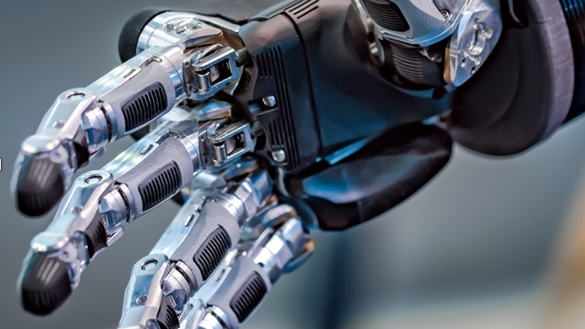
A vital skill these days is data literacy and information literacy. In research from Schield, information literacy is a set of abilities requiring individuals to recognize when information is needed and can locate, evaluate, and use effectively the needed information.
45

Slide 46

An information literate individual is able to: determine the extent of information needed, access the needed information effectively and efficiently, evaluate information and its sources critically, incorporate selected information into one’s knowledge base, use information effectively to accomplish a specific purpose and understand the economic, legal and social issues surrounding the use of information, and access and use information ethically and legally (Schield, n.d.).
Information literacy refers to the ability to find, evaluate and use information effectively and ethically. According to research data literacy is the ability to understand and use data effectively to inform decisions (View of Creating an Understanding of Data Literacy for a Data-driven Society, n.d.). It includes skills such as researching, analysing and communicating information.
Data literacy refers to the ability to understand and work with data, including skills such as collecting and analysing data. Information interpretation refers to the process of understanding and making sense of information, including the ability to identify bias, assess credibility, and contextualize information.
46

Slide 47
Wellbeing, Positive Attitude and Mindfulness
Related skills:
Aspiration
Efficacy and beliefs
Gratitude and hope
Identity, spiritual identity
Metacognition
Mindfulness
Motivation and willingness, taking the initiative
Positive core self-evaluation
Reflection, reflective thinking, evaluating, monitoring
Self-competencies, self-efficacy, positive self-orientation
Trust (in self, others, institutions)
Wellbeing
11
47

Slide 48
Positive attitudes, optimism and a sense of personal purpose enhances the motivation to actively pursue long-term goals. Oxford English dictionary defines motivation as ‘a reason or reasons for acting or behaving in a particular way’ (Simpson, Weiner, & Oxford University Press, 1989). Someone who is motivated to get results notices ways to do better, to be entrepreneurial, to innovate, or to find a competitive advantage (Goleman, 1998).
Motivation is a starting point for successful participation in education and career development. Studies have found out that students with high intrinsic motivation and career self‐efficacy are likely to attain strong educational results (Evans & Burck, 1992). A research by Judge and Bono (2001) has confirmed that individuals which are motivated seem generally more satisfied with their work and perform significantly better than others.
Optimism implies nurturing positive expectations about the possibility of succeeding in the present and the future. Self-efficacy is the sense of one’s worth, and positive belief and confidence in one’s own ability to successfully complete a task, and to obtain a positive outcome in a specific situation. Self-efficacy positively correlates with performance, as it contributes to perseverance and trying harder to succeed (Sala, Punie, Garkov and Cabrera, 2020).
48

Slide 49
Emotional Intelligence and Empathy
Related skills:
Compassion
Conflict resolution
Emotional intelligence
Empathy
Equality, equity
Human dignity
Personal traits
Service orientation
12
49

Slide 50

In 1990, Mayer and Salovey developed their first theory of emotional intelligence. They elaborated a model of emotional intelligence, which consisted of four different dimensions including perception of emotion, emotional facilitation, understanding emotions, and management of emotions (Mayer & Salovey, 1997).
They also proposed that emotional intelligence was a cognitive ability which is separate but also associated to, general intelligence. Their theory was subsequently popularized by Goleman. Goleman proposed (1998) that emotional intelligence was integral for life success.
Emotional intelligence is not fixed genetically but develops throughout life alongside becoming more mature.
50

Slide 51

Emotional intelligence is especially important in complex jobs because a deficiency of these abilities can hinder the use of whatever technical expertise or intellect a person may have.
Goleman advocated that emotional intelligence skills are synergetic with cognitive ones; and top performers have both. divided competencies as purely cognitive, such as analytic reasoning or technical expertise (‘mind’) and emotional competencies, which combine thoughts and feelings (‘heart’) (Goleman, 1998).
51

Slide 52
According to Sala, Punie, Garkov and Cabrera (2020), empathy is the understanding of another person’s emotions, experiences and values, and the provision of appropriate responses. It can be described by the following descriptors:
01
Awareness of another person’s emotions, experiences and values.
Understanding another person's emotions and experiences, and the ability to proactively take their perspective.
Responsiveness to another person’s emotions
02
03
Empathy enables effective communication, interaction and collaboration. It is well-acknowledged that emotional intelligence and empathy can be improved through specific training (Goleman, 1998; Cavallini, Bianco, Bottiroli, Rosi, Vecchi & Lecce, 2015) and it results in outstanding performance at work.
52

Slide 53
Leadership
Related skills:
Leadership and responsibility
Leadership and social influence
Leadership and management
Mobilizing others
Persistence, grit
Persuasion and negotiation
Pro-activeness
Productivity, accountability
Vision
13
53

Slide 54

Leadership skills are particularly important at any managerial position and entrepreneurial activity. Vision refers to a clear and inspiring idea of the future that guides an individual. It is a long-term goal or desired outcome that provides direction and purpose. According to research leadership is the ability to influence the activities of an individual or group toward the achievement of a goal (Addison, 1985).
It is the ability to guide, motivate, and influence a group toward a common goal or vision. It involves setting a direction, creating a sense of purpose, and motivating and inspiring others to work together toward achieving that goal. Research from Elmuti et al. describes leadership as comprising mainly three elements: skills, perspectives, and dispositions (2005).
54

Slide 55
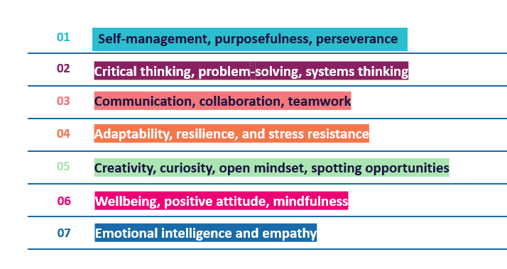
As we will see the Be 21 Skilled Toolkit, we have grouped these competences into 7 key areas. As a teacher, you will be interested in the step-by-step guidance provided for HEI teachers and study program managers to implement hands-on, real-life,
problem-based tools for their students. Check out our website www.be21skilled.eu to start using these tools.
55

Slide 56
Join us to explore
MODULE 2
EMPLOYER PERSPECTIVE, European
www.be21skilled.eu
Skills Panorama, key industry trends

Slide 57



Follow our journey here
www.be21skilled.eu
57

